Slide 1
Equity and Inclusion in Drug Court
2017
Dr. Anne Dannerbeck Janku,
Missouri Office of State Courts Administrator

Slide 2
In this session we will:
Briefly review national work on addressing disparities
Look at the ‘story behind the numbers’ using statistics from Georgia and Missouri
Consider some research findings that may help you create equivalent experiences for all treatment court participants
Identify performance indicators to use in your programs

Slide 3
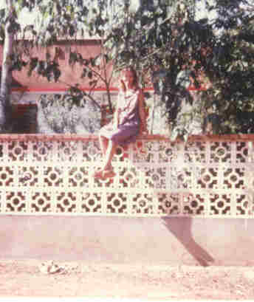
“White people always ask us [black activists] what they can do. We have enough to worry about with plain old survival. I say wholeheartedly to you with no malice: Figure out what you do well and get in the game. Why sit there and wait for us to figure it out? We didn’t create the problems.”
Damon Davis, producer of Whose Streets?, a 2017 documentary film about Ferguson, MO.
Ouagadougou, Burkina Faso, 1981

Slide 4
The National perspective

Slide 5


RESOLUTION OF THE BOARD OF DIRECTORS
ON THE EQUIVALENT TREATMENT OF RACIAL AND ETHNIC
MINORITY PARTICIPANTS IN DRUG COURTS
NOW, THEREFORE, BE IT RESOLVED THAT:
1. All Drug Courts have an affirmative obligation to examine, in an ongoing manner, whether there are potential racial or ethnic disparities in their programs.
2. All Drug Courts have an affirmative obligation to take reasonable actions to prevent or correct any racial or ethnic disparities that may be found to exist

Slide 6

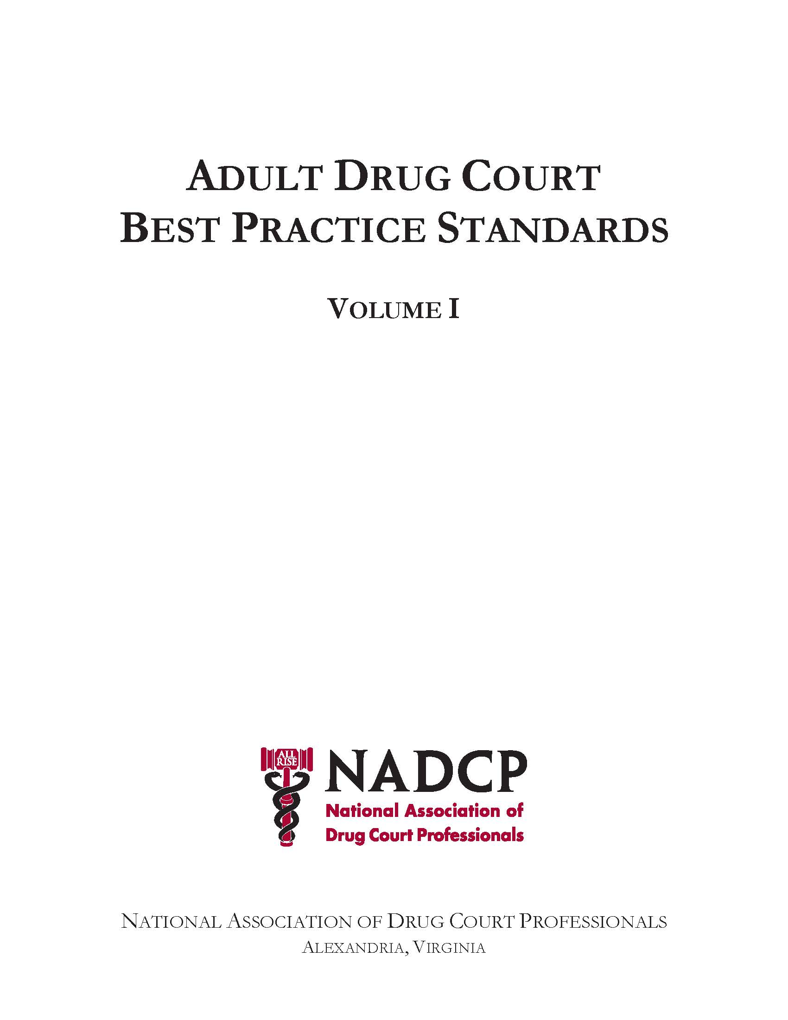
II. Historically Disadvantaged Groups-> Equity and Inclusion
Citizens who have historically experienced sustained discrimination or reduced social opportunities because of their race, ethnicity, gender, sexual orientation, sexual identity, physical or mental disability, religion, or socioeconomic status receive the same opportunities as other citizens to participate and succeed in the Drug Court.
Equivalent Access
Equivalent Retention
Equivalent Treatment
Equivalent Incentives & Sanctions
Equivalent Dispositions
Team Training

Slide 7
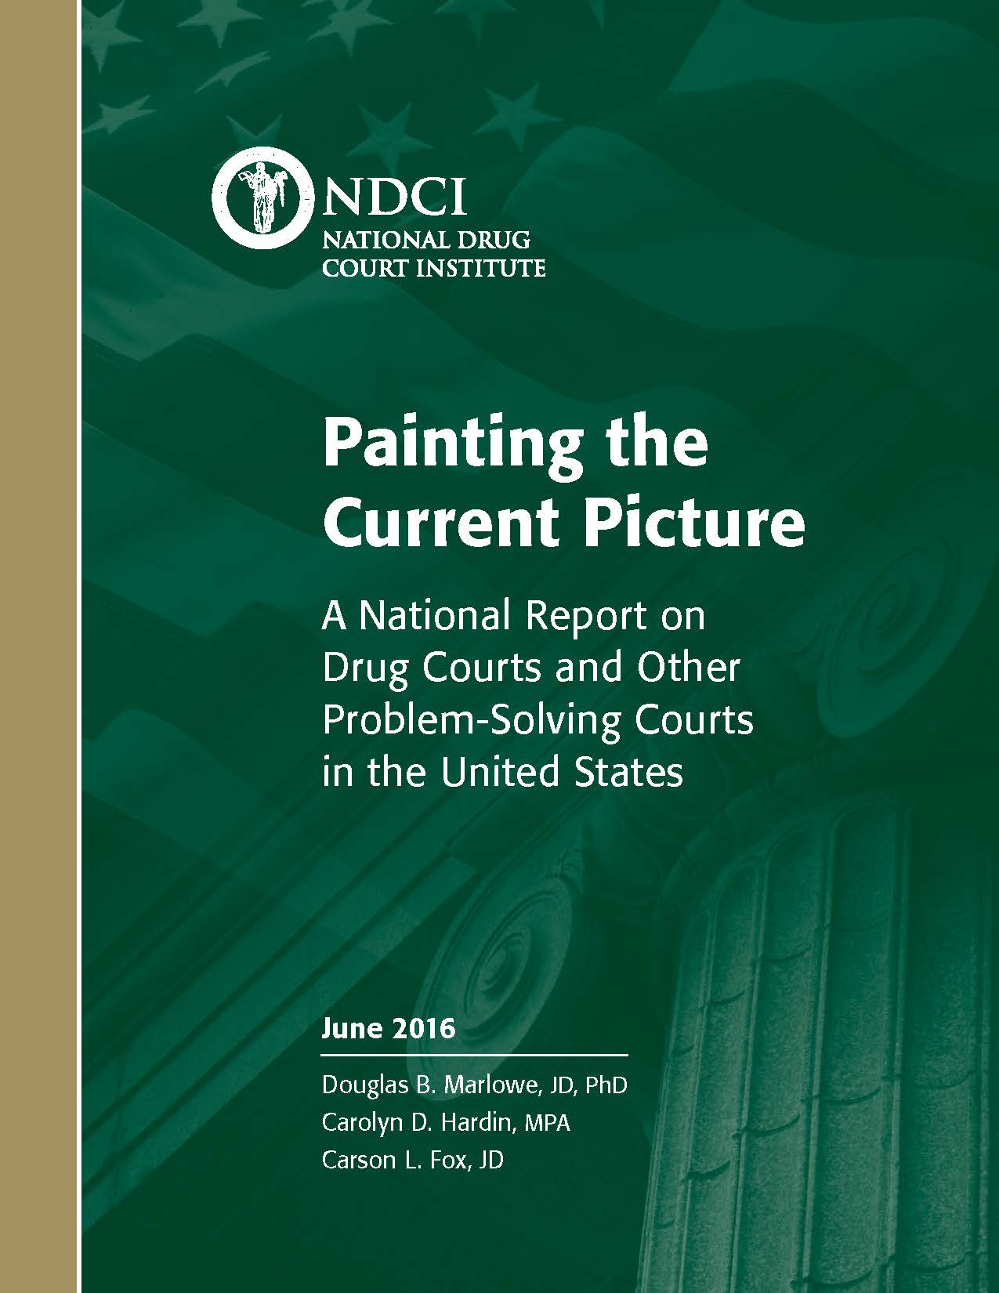

National Report Card:
A Review of the
Scientific Literature
Page 46
How did we do?

Slide 8
Painting the Current Picture
On average, Caucasians represented two-thirds (67%) of participants in respondents’ Drug Courts in 2014, African-Americans represented 17% of participants, and Hispanics represented 10%.
In 2014, representation of African-American and Hispanic individuals in respondents’ Drug Courts was lower than the arrestee, probation, and incarcerated populations.

Slide 9
Painting the Current Picture
Based on available data from roughly one-half of U.S. states and territories, African-American and Hispanic participants graduated from some Drug Courts at rates substantially below those of other Drug Court participants.

Slide 10
Painting the Current Picture
Women represented approximately one-third (32%) of participants in respondents’ Drug Courts in 2014, and appear to have received at least proportionate access to Drug Courts.
Based on available data from roughly one-half of U.S. states and territories, female participants graduated from some Drug Courts at rates substantially below those of male Drug Court participants.

Slide 11
Snapshot of Georgia
SFY16 Active participants across all program types
Race/Ethnic Category | Percent of total, n=4,685
Caucasian | 65%
African American | 30%
Asian | <1%
Hispanic | 3.6%
Other | <1%
SOURCE: Accountability Court Program Output Report Summary (SFY 2016), Council of Accountability Court Judges.

Slide 12
Do no harm…..
Equivalent Dispositions
If 60% of incarcerated drug offenders are African American and 30% of drug court participants are African American, should you recruit more African American participants?
It depends
  On how well the program actually meets their needs,
  On their ability to successfully complete the program,
  And on who is best suited to participate in your program.

Slide 13
Begin with the end in mind
Compare the exit status of your participants in gender/racial/ethnic groups.
Do similar proportions graduate?
If yes, compare your rates to state and national rates.
If the answer is still yes, your program is performing well.
Equivalent dispositions

Slide 14
Begin with the end in mind
Missouri Adult Drug Courts

Slide 15
Performance Indicator
Performance Indicator: your graduation rates compared to state and national graduation rates
Missouri statewide graduation rates for 2016:
  56% Caucasians
  38% African Americans
National graduation rates among BJA recipients*:
  Caucasians: 50%
  African Americans 54%
  Hispanics: 59%
  Native Americans: 47%
  Others: 66%
* West, Kenyon, & Pryce 2016
Equivalent dispositions

Slide 16
Why do population groups graduate at different rates?
Race, a proxy or indicator of bias?
Race may be a proxy for other variables- including bias/prejudicial treatment.
Dannerbeck et al, 2006, found that the effects of race (being black) on graduation probability decreased when one accounted for low community SES, unemployment and low social support.
The more disadvantaged the neighborhood, the less likely an individual is to graduate (Howard 2016).

Slide 17
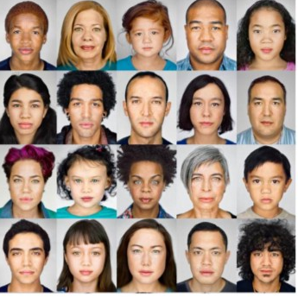
And speaking of race……Mixed Race
3% of US population identifies as mixed race with the largest proportion identifying as White and Native American (US Census 2010)
Not much research because of the tremendous diversity of individuals who could potentially be considered mixed race
Implications of self-identification
  Risk and needs indicator
  Tends to fluctuate over the life course
Implications of ‘observer’ identification
  Monitor practices for potential discrimination

Slide 18
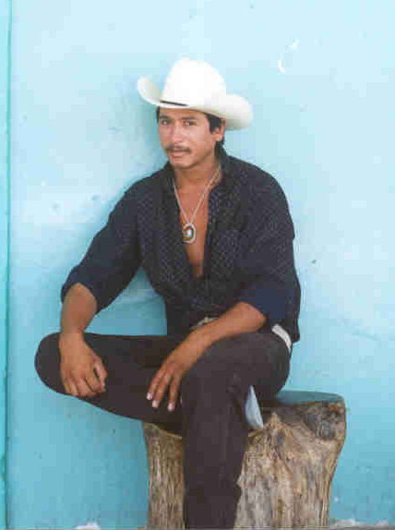
And speaking of ethnicity……
Latinos and Cultural Identity
<><><><><><><><>
Is it of value to maintain cultural identity?
Yes No
Yes Integration Assimilation
No Separation Marginalization
Is it of
value to
maintain
relation-
ships with
other
groups?
Notes:
Can be an assessment tool
Dissonant acculturation and marginalization- individual confronts discrimination, bifurcated labor markets, tend to join adversarial peer subcultures for support --> underclass status, poverty
dissonant accult. & assimilation- loss of parental authority, role reversals--> underclass status, poverty
separation & consonant acculturation-discrimination and bifurcated labor markets met with family support, family aspirations keep individual focused despite discriminatory barriers-->slowly move up in socioeconomic status
integration and selective accult.- discrimination and bifurcated labor markets met with family and community support, social networks strong--> upward socioeconomic status with bicultural identity intact

Slide 19
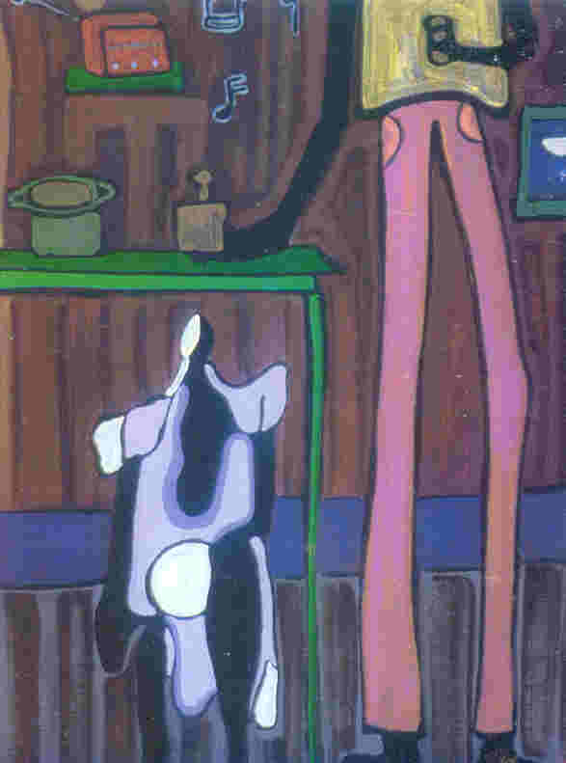
Women and Drug Court
“My child’s first sentence was: ‘Mommy with her PO.’ I cried.”
female drug court participant, 2015
Gender specific issues: Trauma, domestic violence, child care, guilt
Self-medicating for abuse and trauma
12-step programs designed for men
Gender responsive programs lead to better drug court outcomes
Artist, Patricia Erickson
Costa Rica

Slide 20
Begin with the end in mind
Outcomes for Participants from a Health Perspective
Reduction in stress
Improvement in behavioral health issues (depression, substance use disorders)
Increase in strength and resiliency

Slide 21
Understanding Disparities in Outcomes
Social Indicators of Health and
Health Disparities
Stress (poverty, discrimination) and coping
Discrimination has an additive effect above other social determinants of health status that often leads to the elevation of chronic stress hormones which have a corrosive effect at the cellular level (Swain, Johnson, & Ports, 2016).
Parents who experience chronic stress can pass on changes in gene expression at the cellular level. The effects on the children are the same as if they had directly experienced the stress.

Slide 22
History
Slavery. Did there ever exist a more annoying way to try to make a modern-day black man feel like his troubles were insignificant, that he should be satisfied with the sorry hand society dealt him? Cha-Cha, a character in Angela Flourney’s The Turner House, p 82
Amazing how in the beginning of time we were the first people to have a great civilization and we were some of the most important people on this planet. Then 1000s of years of erasing our history and hundreds years of us being chained up and brought down. And now we are here. We see more of us than of them [in prison]. Focus group participant

Slide 23

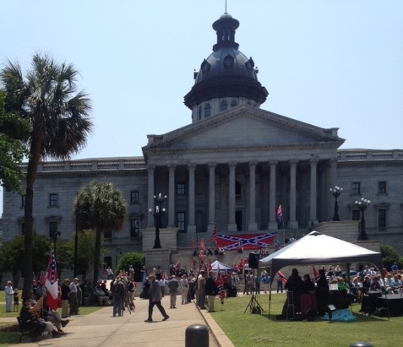

Post traumatic slavery syndrome
State Capital
Columbia, SC, May 2015
Confederate Memorial Day

Slide 24
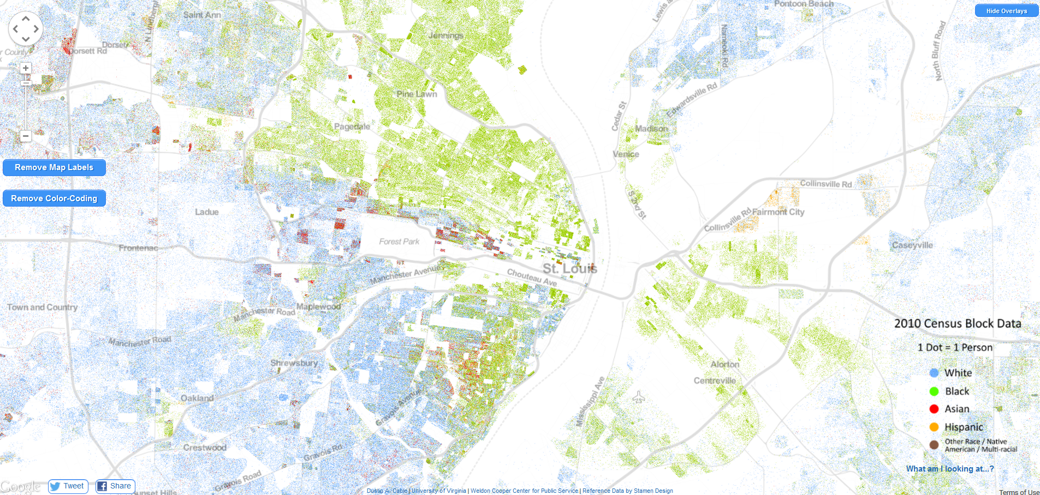
Where do your participants live?
St. Louis, MO
Blue dot= white person; green dot= black person
Source: http://demographics.coopercenter.org/DotMap/

Slide 25
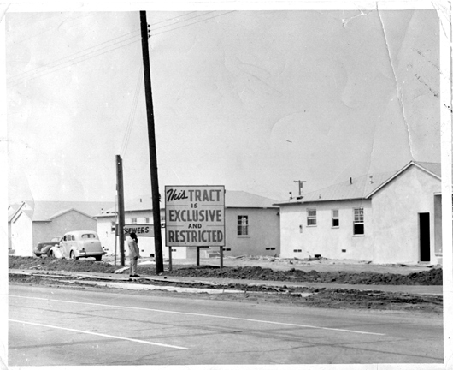
Residential Segregation
Neighborhood segregation may create differences in:
  employment opportunities,
  community resources,
  transportation access,
  treatment availability
  and other factors that impact drug court participant success.
1950s, Los Angeles, CA

Slide 26
Neighborhood Disadvantage
What participants say
Biggest thing from Af Am standpoint, know white pp using drugs. Don’t buy drugs in their neighborhood. They go somewhere or someone brings them the drugs.
Coming from neighborhood where gangs and drugs are part of neighborhood environment, it is difficult to come in program like this where you are expected to follow the straight and narrow and be clean but you are back home to that.
Growing up we had opportunities, had parks, community centers. Mom and pop stores. Resources in community allowing us to live effectively as a community. Had grocery stores, dental clinics, family practice health care. Stores selling fruits and vegetables.
Today don’t have those resources.
No resources for individual to come out and be productive.

Slide 27
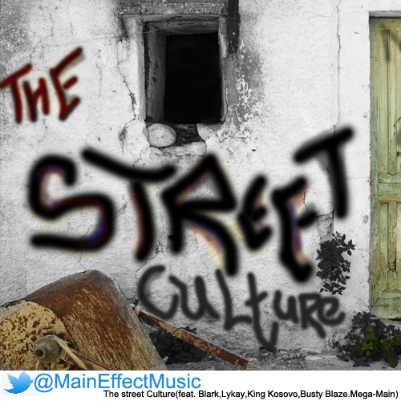
Culture of the Streets
Many African-Americans relate to the culture of the streets.
You have people who grew up, their mama not there, daddy locked up, no uncles or anybody to guide them so they feel like the streets is right here and the streets is their home and they are protected when they around the people in the streets because those people feed them, help them, do things for them, rob for them. The streets is their home, that’s why they fall right in, join a gang. Certified youth
Didn’t want to be told what to do, when to do it and how to do it. I’m a man and I have been living on the street and I’ve been doing what I been doing to get by. So how dare somebody come and try to tell me how to live my life. Focus group

Slide 28
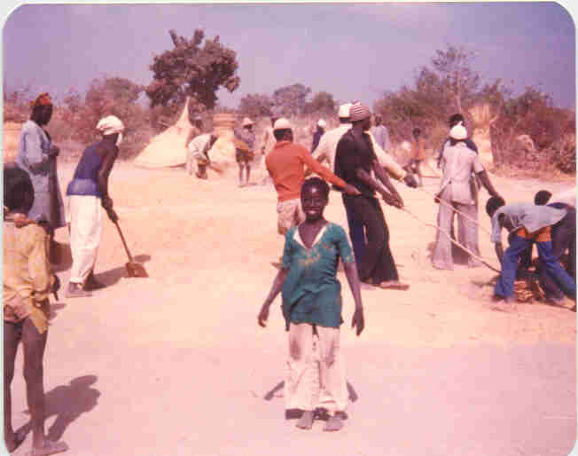
Wealth accumulation through respect and social relationships
Digre, Burkina Faso, 1981

Slide 29
A Deficit of Trust
I have been disrespected by the system. Say I am tall, African American, and have short hair. I could be walking down the street and get stopped multiple times because I fit the description: tall, African American, short hair. Once I was walking from my house to a park and I got stopped three times. Why? I didn’t do nothing. (certified youth)
When you have been arrested and locked up you get used to a system. People enter drug court with the idea that its just like the rest of the system. There’s unconscious distrust of anybody in authority positions. Focus group
Painting by Lynette Yaidom-Boakye
As printed in Vogue April 2017

Slide 30
Coping Strategies
“Relationship frequently trumps everything else.” (p. 28)
“Greeting becomes a symbol which underscores the importance placed on the relationship.” (p. 31)
Possible association between performance and perceptions of one’s relationship with those in charge.
Hypersensitivity about matters of respect.
Source: DeGruy 2005

Slide 31
Drug Court Responses: Procedural Justice
Participants often mention their relationship with the judicial officer as a key element of their success. Research suggests that the principles of procedural fairness are strongly associated with success (Mackenzie 2016). While these principles apply to all individuals, pursuing equivalency may involve changing one’s approach to pursuing these principles with African- American participants.
  Give participants a voice in court proceedings and let them know that their voice is heard.
  Practice neutrality by listening and invoking laws and rules to explain consequences. Participants who perceive that decisions are made based on facts and known rules rather than opinions are much more likely to abide by the decisions.
  Legitimacy is created when individuals are treated with respect. Respect is a valuable resource for many low income individuals, especially minorities who may experience discrimination. Some drug court studies report that minorities are more likely to report feeling disrespected in treatment court programs (Gallagher 2013).
  Exhibit trustworthiness by showing participants that the treatment team cares about them and wants them to succeed. Trust can also be earned by explaining the rationale for decisions.

Slide 32
Drug Court Responses: Procedural Justice
Participants often mention their relationship with the judicial officer as a key element of their success. Research suggests that the principles of procedural fairness are strongly associated with success (Mackenzie 2016).
  Voice I knew they listened to me when they gave me a travel pass.
  Neutrality There are rewards for those who do well and punishments for those who do bad. That’s just the way it is in this program.
  Trustworthiness Drug court peoples you can see the hand they offer to you. Give you chance to help yourself.
  Respect Showed disrespect in the way they talk to us sometimes.

Slide 33
Performance Indicators
Interview Participants
  What makes it hard for you to successfully complete the Drug Court Program (e.g., lifestyle, family influences, time commitment, neighborhood)?
  What triggers make it hard to stay clean and sober?
  Do family and friends know you are in drug court? And support you?
  Among program staff, who do you talk to when you’re having a tough time? What helps you feel comfortable talking to him/her?

Slide 34
Equivalent Treatment
Recognize that equivalent does not mean treating people the same.
Equivalent
  Equal in effect
  May differ in appearance but has the same value to the recipient
The trauma of racism and discrimination and the role of drugs and drug trafficking in coping with such discrimination may need to be addressed in treatment.

Slide 35
Equivalent Treatment
Some factors to consider
African Americans may cope with stress through: smoking, alcohol, drugs, comfort foods (Mezuk et al. 2011).
African Americans have a lower incidence of mental health problems than similarly situated whites (Kressler, et al. 1994) but more physical health problems over the life course.
African Americans are treated differently in health care settings.
They are less likely to have their pain acknowledged and treated than are similarly situated Caucasians. False stereotypes may be factors driving this trend. (Meghani, Byun, & Gallagher, 2012).

Slide 36
More factors to consider
Minorities report lower levels of satisfaction with treatment (Wells et al. 2001). They underutilize treatment because of:
  potential stigma (Menke & Flynn 2008),
  distrust of providers (Freimuth, Quinn, & Thomas 2001)
  and lack of financial resources (Hines-Martin, et al. 2003).
Lower levels of education and income in the community may impact participants’ self-efficacy and their perceptions of the benefits of staying in treatment (Saloner & Cook 2013).
To engage minority participants in treatment, providers need to have staff who understand the participants and are knowledgeable about their daily lives (Guerro, et al. 2013.)

Slide 37
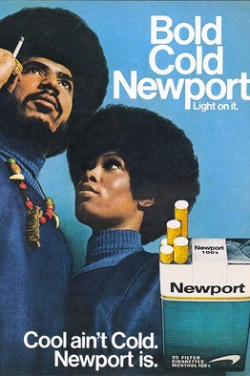
Coping
Smoking patterns
Smoking at age 50 accounts for 20% to 48% of the black-white gap in male life expectancy.
Black men are more likely to be ever smokers.
Black men have lower cessation rates.
Smoking serves as a self-medicating mechanism and form of relaxation among low income individuals facing high levels of stress. (Ho & Elo 2013)
Blacks tend to smoke fewer cigarettes but are more likely to smoke menthol cigarettes (which numb throat and allow for deeper inhalations) and those with higher tar yields experience higher indices of smoke exposure and may be at risk for greater physical dependence. (Sellers 1998)

Slide 38
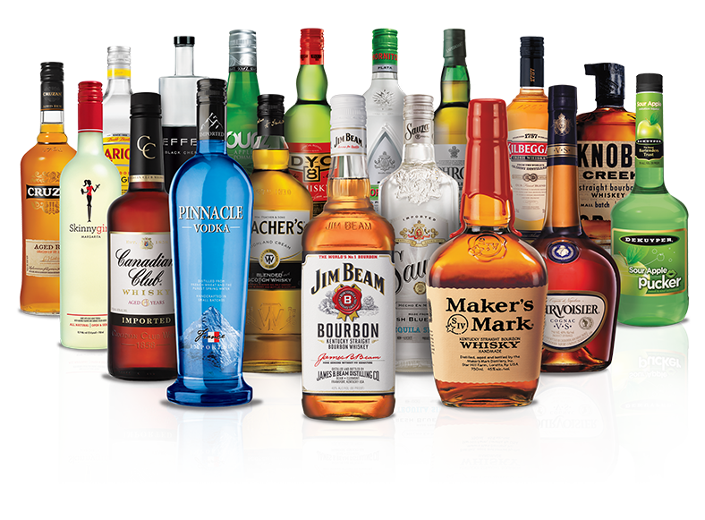
Coping: The Alcohol
Paradox
African Americans are more likely to abstain from drinking than are whites yet they are more likely to be problem drinkers. (Keyes, et al. 2015).
Problem drinking among African Americans is linked to discrimination. (Borrell et al. 2013)
Having religious beliefs and engaging in religious behaviors protect against problem drinking.
Having such beliefs without a religious practice actually increases the risk of alcohol abuse. (Brechting et al. 2010)

Slide 39
Coping: Religion and Faith-Based Institutions
African Americans may utilize religious and spiritual coping mechanisms. (Neblett, et al. 2010)
For those under financial stress, ‘the collection basket’ can be another stressor (Hudson et. al. 2016).
Potential stigma among church attendees about associating with justice-involved individuals and their families. (DeGruy 2005)
Younger generation don’t have same feelings about church. Seen as European, from slavery. Focus group

Slide 40
Being color blind is not helpful
“We treat everyone the same in our drug court program.”
Research indicates that practicing an ideology of color blindness is ineffective, provokes interracial tension, and promotes inequality. (Neville, et al. 2013).
What to do instead?
  Discourage color blind attitudes among staff.
  Engage in hard discussions about how race may matter in your program.
  Include community partners and participants in these discussions.

Slide 41
Drugs may not be the ‘problem’
Not just focus on drug treatment because that is not an addict’s whole downfall. Drugs is not the problem. Addicts have more than one problem.
All you focus on is drug problem, then you aren’t going to get down to the serious problems.
Education might be a much bigger problem than drugs.
Job problem might also be bigger.
I don’t want to play the race card but being African American it really does make a big difference, especially when you are a felon.
Equivalent treatment

Slide 42
What type of services?
Focus on Habilitation- skills training for a career not just a job
The evidence points to a need to focus on habilitation (being able to function independently in an adult world) especially for poor urban men, 50% of whom are black or Hispanic. (Institute on Research on Poverty 2016)
2/3 are fathers with children raised in female headed households.
60% have not worked in past 12 months.
Employment rates for urban black men have decreased from 73.4% in 1970 to 44.7% in 2010 vs. from 85% to 77% for white men.
50% of black and Hispanic men have been arrested by age 35.
Employment status at drug court entry is a significant predictor of exit status. Providing an equivalent experience may entail offering additional resources for employment supports.
Equivalent treatment

Slide 43
Equivalent Retention
Most difficult group across types of interventions: young black males, 17-25
Typical comment: “I’m not an addict. I just choose to smoke weed. Its part of my lifestyle.”
Emerging adult characteristics- brain not mature, weak connections to social control mechanisms, establishing a lifestyle
High prevalence of gateway drugs-alcohol and marijuana –related to experimentation, instability and stress, peer influence (Dannerbeck, 2010)

Slide 44
Performance Indicators
Break down participants by age group:
  17-25 emerging adults
  26-35 young adults
  36-60 middle adults
  60+ older adults
  Look at length of time in program, risks, needs
  Look for patterns of absconding, early termination
  Interview participants
    What do you like least about the Drug Court Program?
    What has been the most helpful thing about the Drug Court Program?
    What did you hear about drug court before you entered?
    Why did you decide to participate in drug court?
Equivalent Retention

Slide 45
Retention
I don’t have none of that addiction stuff. I don’t even see why I am in drug court. I guess because I had drugs but I don’t know what. They should have a different program to talk about how to get money. They should put me in a different room to talk about why I want fast money. . . I don’t have an addiction it is more of a lifestyle. You know how you grow up seeing your older cousins and brothers doing this. You like what you see. They have good clothes, shoes, game systems. Just trying to live the good life. Without having to do nothing for real for it just somebody put it in your hand real quick and easy like that. None of that ‘oh my feet hurt’ coming home from work type stuff. Reintegration evaluation

Slide 46
To help with retention, assess for risk and needs
MO Drug Court Exits by Race & RANT Score
Risk/Need | Hi/Hi | Hi/Low | Low/Hi | Low/Low
White | 666 81% | 75 9% | 51 6% | 30 4%
Black | 183 64% | 74 26% | 14 5% | 13 5%

Slide 47
HEAT, A promising intervention
Habilitation, Empowerment and Accountability Therapy
created by Guy Wheeler and Darryl Turpin
Manualized cognitive behavioral therapy designed for those who identify with the culture of black males between the ages of 17 and 29
Focuses on spirituality, community, family and self.
Geared to reduce recidivism, reduce drug use, address trauma, ambivalence and resistance

Slide 48
Consider ways to connect your program to the participants to improve retention
A recent Pew Research Center study (2015) found that young adults, those with low incomes and minority status were the groups most likely to be smart-phone dependent. How can you use this device to enhance access to your program?
Send text reminders about appearance dates.
Clinicians and probation officers can do quick check-ins on mental state, cravings, or activities to see how participants are doing.
Drug testing reminders can be sent via text.
Some clinical interventions may be conducted over smart-phones.
On-line reviews of NA/AA groups can help individuals find a good match.
Create an app for stress reduction.
Link participants to health literacy information.
Community members can form a virtual network to offer support to participants. (Anderson & Olson, 2016)
Equivalent Retention

Slide 49
Incentives and sanctions
Performance indicators
Interview participants
  Were sanctions used as a punishment or a form of help?
A jail sanction doesn’t help if you are used to being locked up. You are used to that. Its comfortable. Give people the opportunity to step outside themselves, go talk at a youth center. Drug court participant
Nurturing self efficacy- helping participants vs. giving them what they need to do things themselves

Slide 50
Equivalent Opportunity in Drug Court
If your rates didn’t measure up to state and national benchmarks, you examined your program.
Are you accepting the appropriate people based on their risks and needs?
  Especially regarding addiction vs. abuse and mental health status, trauma/racism?
Are you providing the appropriate services to meet those risks and needs?
And providing the services in a culturally appropriate manner?
Then it is time to consider program access.

Slide 51
Recognize when Equivalent Access is not being Achieved

Slide 52
2016 Statewide Statistics related to Adult Treatment Court
 | Black Females | Black Males | White Females | White Males
Proportion of all Felony Drug Charges Filed | 2% | 15% | 29% | 52%
Proportion of all Admissions | 4% | 12% | 33% | 49%
Proportion of in group exits graduating | 34% | 36% | 57% | 56%

Slide 53
Recruitment considerations
Why are certain groups underrepresented in your program?
  Prosecutorial decisions or judicial considerations?
  Word on the street – “Drug court is a trap.”
  Other access issues: affordability, transportation, scheduling, neighborhood
  Eligibility criteria-are any unnecessarily exclusionary? Language, housing stability, geography,
  Perceptions of program requirements- a help or a burden?
  At orientation they throw a lot of rules at you. ‘Do this.’ ‘Don’t do that.’ There was no focus on how the program can help you. A lot of guys decided they didn’t want to go through it. Focus group
Equivalent Access

Slide 54
Performance Indicator
Understand reasons for non-admittance
Reason for Non-Admittance | Black Females | Black Males | White Females | White Males
Defendant Opt-Out | 12/33% | 78 /37% | 123/37% | 134/27%
Medical | 1 | 0 | 6 | 8
Mental Health | 0 | 2 | 5 | 10
Admit to Other Treat Pgm | 0 | 0 | 6 | 5
Dismissed | 0 | 1 | 8 | 13
Judicial Override | 0 | 3 | 13 | 39
PA Decision | 18/ 50% | 262/ 68% | 81/ 24% | 145/29%
Not Eligible | 5/ 14% | 39/ 10% | 91/ 27% | 138/28%
TOTAL | 36 | 385 | 333 | 492
Cases that received a RANT but were not admitted to Treatment Court, Jan 1, 2014 through December 31, 2015

Slide 55
Poverty and Access to Drug Court
“Participants who are employed at program entry and who can pay their fees are more likely to graduate. “ program staff
Ask the following at program entry:
To what extent do you think your income is enough for you to live on?
  Not at all adequate
  Can meet basic necessities only
  Can afford some of the things I want
  Can afford about everything I want
  Can afford everything I want and still save money

Slide 56
Key Component #10
Community partnerships
In 2015 NPC Research completed a best practices assessment of Missouri drug courts.
Just 16% had a community partnership.
Who should be included in such a partnership?
  Related agencies like mental health, prosecutors
  Reps from community organizations (including faith based) serving neighborhoods where target population resides, key employers, and the informal go-to people from neighborhoods and schools.

Slide 57
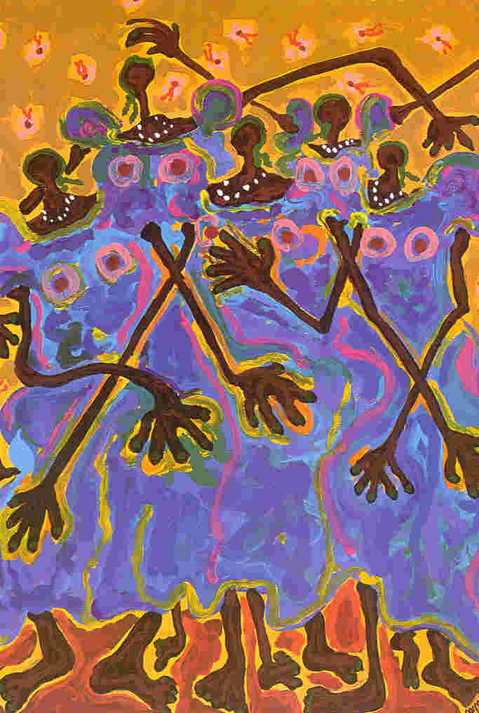
Community partners can….
Review eligibility criteria and program requirements for potential impacts on specific populations
Help find staff who are knowledgeable about the world view of the population
Help identify ancillary services of benefit to DC participants
Identify barriers to accessing drug court services and possible ways to overcome barriers
Share the word on the street about drug court

Slide 58
Create an atmosphere of social accountability
Plays into our desire to look good to our peers. Knowing that we may have to explain our decisions leads us to change our behavior (Dobbin & Kalev 2016)
Discourage color blind attitudes among staff.
Provide training on implicit bias and
Use performance indicators, both statistics and interview materials to engage in continuous improvements.
  Have staff review them regularly
  Have a stakeholder group review them periodically and ask questions.

Slide 59
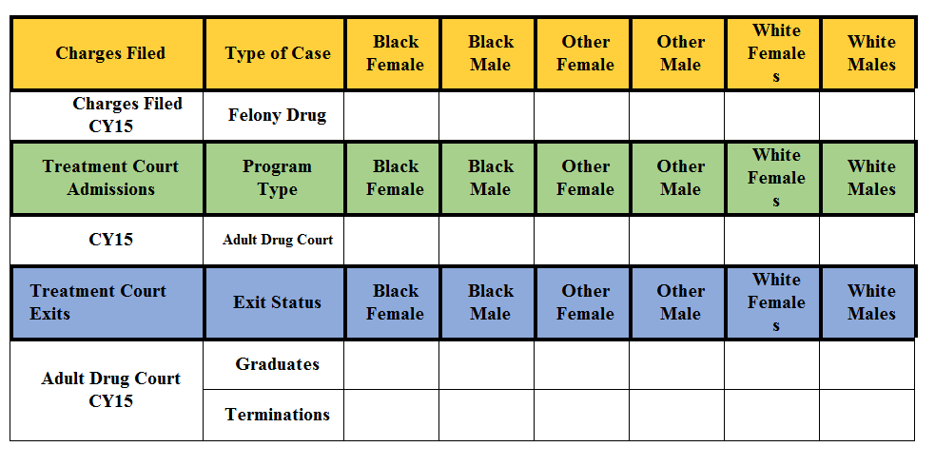
Distribute Status Reports including:
A review of the jurisdiction's charges filed population vs. the treatment court population was conducted and is outlined in the tables below.

Slide 60
MATCP Committee for Equity in Missouri Treatment Courts
Promote training on equity in treatment courts
Make recommendations on treatment and practice

Slide 61
References
Anderson, K. and Olson, S. 2016. The promises and perils of digital strategies in achieving health equity: Workshop summary. Washington, DC, National Academies Press. http://www.nationalacademies.org/hmd/Reports/2016/Promises-and-Perils-of-Digital-Strategies-in-Achieving-Health-Equity.aspx
Borell, L., Keife, C., Diez-Roux, A., Williams, D. & Gordon-Larson, P. 2013. Racial discrimination, racial/ethnic segregation, and health behaviors in the CARDIA study. Ethnicity and Health, 18, 3, 227-243.
Brechting, E., Bronw, T., Salsman, J., Sauer, S. Holeman, V. & Carlson, C. 2010. The role of religious beliefs and behaviors in predicting underage alcohol use. Journal of Child and Adolescent Substance Abuse, 19, 4, 324-334.
Dannerbeck, A. Harris, G., Sundet, p., & Lloyd, K. 2006.Understanding and responding to racial differences in drug court outcomes. Journal of Ethnicity in Substance Abuse, 5, 2, 1-22.
Dannerbeck, A. 2010. Examining emerging adulthood in the context of the justice system. In Douglas, E. (ed.) Innovations in child and family policy, Lanham, MD: Lexington Books.
DeGruy, J. 2005. Post traumatic slave syndrome. Baltimore, MD: Upton Press.
Flournoy, A. 2015. The Turner House. New York: Houghton Mifflin Harcourt Pub.
Freimuth, V., Quinn, S., Thomas, S. et al. 2001. African Americans’ views on research and the Tuskegee Syphilis study. Social Science and Medicine, 52, 797-808.
Guerro, E., et al., 2013. Disparities in completion of substance abuse treatment between and within racial and ethnic groups. Health Services Review, 48, 4.
Henderson, L. 2017. Racial discrimination, religion, and the African American drinking paradox. Race and Social Problems, 9, 79-90.
Hines-Martin, V., Malone, M. Kim, S., et al. 2003. Barriers to mental health care access in an African American population. Issues in Mental Health Nursing, 24, 237-256.
Ho, J. & Elo, I. 2013. The contribution of smoking to black-white differences in U.S. mortality. Demography, 50, 2, 545-568.
Howard, D. 2016. Race, neighborhood, and drug court graduation. Justice Quarterly, 33, 1, 159-184.
Hudson, D., Eaton, J., Lewis, P., Grant, P., Sewell, W., & Gilbert, K. 2016. “Racism?!?..Just look at our neighborhoods”: Views on racial discrimination and coping among African American men in Saint Louis. Journal of Men’s Studies, 24, 2, 130-150.
Institute for Research on Poverty. 2016. Living on the periphery: Poor urban men. Focus on Policy, Univ. of Wisconsin, Madison, WI. Available at: http://www.irp.wisc.edu/publications/policybriefs/pdfs/PB10-Urban-Men.pdf
Kessler, R. McGonagle, K. Zhao, S. et al. 1994. Lifetime and 12-month prevalence of DMS-III-R psychiatric disorders in the United States: Results from the National Comorbidity Survey. Archives of General Psychiatry, 51, 8-19.
Keyes, K., Vo,. T., Wall, M. Caetano, R., Suglia, S., Martins, S., et al. 2015. Racial/ethnic differences in use of alcohol, tobacco, and marijuana: Is there a cross-over form adolescence to adulthood?? Social Science and Medicine, 124, 132-141.

Slide 62
MacKenzie, B. 2016. The judge is the key component: The importance of procedural fairness in drug-treatment court. Court Review, 52,1, 8-34.
Meghani, S., Byun, E., and Gallagher, R. 2012. Time to take stock: A meta-analysis and systematic review of analgesic treatment disparities for pain in the United States. Pain Medicine, 13, 12, 150-174.
Menke, R. and Flynn, H. 2009. Relationships between stigma, depression, and treatment in white and African American primary care patients. Journal of Nervous and Mental Disease, 197, 407-411.
Mezuk, b., Rafferty, J., Kershaw, K., Hudson, D., Abdou, C. Lee, H. and Jackson, J. 2011. Reconsidering the role of social disadvantage in physical and mental health: Stressful lie events, health behaviors, race, and depression. American Journal of Epidemiology, 172, 1238-1249.
Neville, H., Awad, G., Brooks, J., Flores, M., and Bluemel, J. 2013. Color-Blind racial ideology: Theory, training, and measurement implications in psychology. American Psychologist, 68, 6, 455-466.
Pew Research Center. 2015. A portrait of smartphone ownership. Available at: http://www.pewinternet.org/files/2015/03/PI_Smartphones_0401151.pdf
Sellers, E. 1998. Pharmacogenetics and ethnoracial differences in smoking. Journal of the American Medical Assoc., 280, 179-180
Swain, G., Johnson, S., and Ports, K. 2016. How economic and social disadvantage affect health and life opportunities. Webinar. Institute for Research on Poverty, Univ. of Wisconsin, Madison, WI. June 8. http://www.irp.wisc.edu/publications/media/webinars2015-2016.htm
West, V., Kenyon, M., and Pryce, D. 2016. Draft Demographic Profiles of BJA-Funded Drug Court Participants. Presentation. Alexandria, VA: National Association of Drug Court Professionals, March.
Wells, K., Klap, R., Koike, A., et al. 2001. Ethnic disparities in unmet need for alcoholism, drug abuse and mental health care. American Journal of Psychiatry, 158, 2027-2032.
Saloner, B. and Le Cook, B. 2013. Blacks and Hispanics are less likely than whites to complete addiction treatment, largely due to socioeconomic factors. Health Affairs, 32, 1,135-145.

