Slide 1
LAW ENFORCEMENT SUPPORT TO ACCOUNTABILITY COURTS
PRESENTED BY
Athens-Clarke county probation services

Slide 2
LE/SURVEILLANCE OVERVIEW
Mission
The mission of law enforcement/surveillance operations is to lend support to the Accountability Court Team in needed areas, such as office visit supervision, home/work site visits, drug testing, and electronic monitoring as necessary. The officer should attend team meetings, staffing, and court whenever feasible. The officer is a valuable member of the team that brings certain skill sets to the table to assist in the participant’s success in the Accountability Court Program.

Slide 3
Basic Role
Enforce the Court Order.
Provide information to the Accountability Court Team.
Participate in the team’s ongoing assessment of a participant’s progress.
Participate in Accountability Court training further developing their special skills to apply in support of the team’s mission.

Slide 4
Special Skills and Abilities
POST Certified Sworn Officers.
Crisis Intervention and Personal Interaction skills.
Home/Work Site visits.
Drug/Alcohol testing knowledge and equipment.
Knowledge of current electronic monitoring equipment and its applications.

Slide 5
Why you should use LE/Surveillance Officers
Safety.
Trained Officers for house/work visits.
Trained on specialized equipment.
A “neutral party” so that the Coordinator, other staff, and judge may make non-biased and informed decisions.

Slide 6
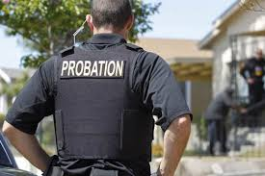
Field Services

Slide 7
LE SUPPORT IN THE FIELD
Home/Work Visits
General Contact/Welfare check
Drug Testing
4th Amendment Searches
Requested checks by Coordinator or Counselors

Slide 8
Field Services Continued
Safety
Recommend two-person teams
Recommend visits be done during appropriate/designated hours
Participants should be aware of hours that officers may visit
Scope of action is limited to what is authorized by court order and participant agreements
Court Order vs. police approach
Separation of approach is best practice

Slide 9
Field Services Reporting
Request for Field Visit
Results of Field Visit
Document all contacts for staffing

Slide 10
Field Services

Slide 11
Electronic Monitoring
Electronic Monitoring is a very useful tool, but only as good as the people implementing the program and the data available.
Can be used in conjunction with a sentence or as a short-term sanction.
We have found that the longer someone is on restrictive monitoring, the more likely they are to violate.
Historically, the technology allows for curfew monitoring, GPS monitoring, and alcohol monitoring.
There is a wide variety of technology and associated services available.

Slide 12
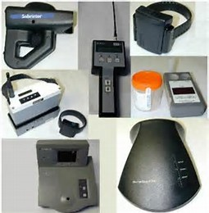
Electronic Monitoring
RF Monitoring
GPS Monitoring
One piece
Two piece
Alcohol Monitoring
MEMS
SCRAM
CheckBAC

Slide 13
Electronic Monitoring
Overview of uses (sentence, sanctions)
Limitations
Cost
Future of EM
Technology always updating
Virtual Supervision becoming possible

Slide 14
Drug Testing
Why Drug Test
To ensure compliance with sentence or program rules.
To promote public safety by acting quickly in the event of relapse.
To identify and address substance abuse problems early on.
Drug Testing is a tool, not a solution.

Slide 15
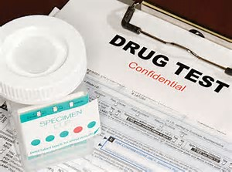
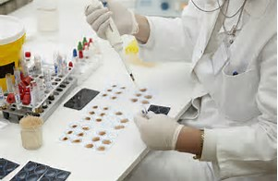
Drug Testing
Varied types of testing available.
Cups/Sticks; Immunoassay; LC/MS and Specialty Testing.
Pro’s and Cons

Slide 16
Pros and Cons of Various Urine Testing Methods
 | Pros | Cons
Stick/Dip | Inexpensive Instant Can be conducted outside of lab | Less accurate Positives are only preliminary and must be confirmed by lab
Cup Tests | Inexpensive Instant Can be conducted outside of lab Wide range of drugs tested | Greater accuracy than stick Positives are only preliminary and must be confirmed by lab
Immunoassay | Can provide quantitative data Highly accurate | More expensive than stick/cups Results take longer Should still confirm positives to rule out cross-reactivity
LC-MS/GC-MS | Most accurate testing available Gives most conclusive results | Takes longer for results Tends to cost much more

Slide 17
Best Practices
Always have authority to test
Observed testing is essential
Document chain of custody from point of collection to securing of sample.
Watch for Falsification/Adulterants.

Slide 18
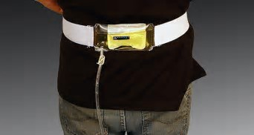
FALSIFICATIONS or How I went to Jail Really, Really Fast!

Slide 19
Summary
LE Support is crucial to the mission of Accountability Courts.
They represent multiple tools that can be used for both accountability and treatment response.
As with all tools, it is important to have the training and process to implement their use.
Feel free to contact our office. We are always glad to assist!

Slide 20
Questions
How may we help?
Dale Allen
Chief Probation Officer
dale.allen@athensclarkecounty.com
706-613-3911 x226

