Slide 1
Making Family Treatment Courts Work for your Jurisdiction
Judge Philip B. Spivey
Juvenile Courts
Ocmulgee judicial Circuit
Judge Alison W. Toller
Juvenile Courts
Northeastern Judicial Circuit

Slide 2
FAMILY Treatment Court

Slide 4
Family Treatment Court (FTC)
MISSION:
Reduce Foster Care Stays
Promote Family Reunifications
Target Families/Parents with Substance Abuse Issues

Slide 5
The protection, best interest and permanency of children
The promotion of safe and stable families through abstinence from alcohol and drugs
The promotion of law abiding behaviors in the interest of public safety while addressing the comprehensive needs of parents and children
Targeting permanency for children who have been exposed to parental substance abuse

Slide 6
Senate Bill 367 Signed April 27, 2016
Recognizes Family Treatment Court Divisions within a Juvenile Court as Accountability Courts
Includes Presiding Judges of FTCs as members of the Council of Accountability Court Judges
Allows the transfer of Felony Drug Court Cases to FTC if meets certain criteria
Requires the adoption of standards, certification, and peer review for FTCs
Amended OCGA 15-11-15 and added 15-11-70

Slide 7
Transfers
Have the support of your State and Superior Court Judges, especially those from the other accountability courts in your circuit.
Can be accepted as a condition of bond, a condition of probation, or from one accountability court to another.
Benefit: treating the parents and the family vs. just the offender; often these candidates have open DFCS cases but petitions are slow to follow.
Sanction through designation order rather than contempt sanction, return to original court for sentencing/disposition if not successful.

Slide 8
Funding
This year the Governor budgeted, the Legislature approved, and CACJ will distribute $2,046,636.00 in grant funds from the State to Family Treatment Courts
Typically grant applications are due in early March; Awards are generally announced by mid May
The FY18 Accountability Court Supplemental Grant Application will be released 9/25/17.
Courts must be certified or have received a waiver to be eligible for grant funding

Slide 9
WHAT DO YOU NEED?
Collaborative Team
Multi-disciplinary Team
Coordinated Strategy
Evidence Based Treatment
Continuum of Services for Parents and Children
Rigorous Drug and Alcohol Screening
Ongoing Judicial Interaction with Participants
Partnerships

Slide 10
WHO DO YOU NEED?
Judge
Coordinator
SAAG
Child Attorney
Parent Attorney
CASA
DFCS Representative
Treatment Provider
Community Policing
Prosecutor/Defense Attorney
Others

Slide 11
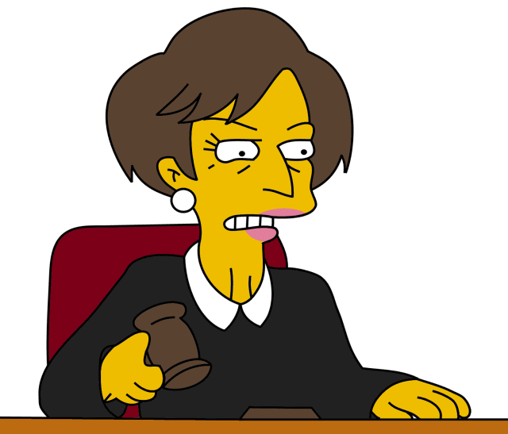
JUDGE

Slide 12
JUDGE’S ROLE:
ensure the safety, permanency, and well-being of children
provide leadership
serve as the public face of the Family Treatment Court
ensure children and participants receive appropriate services;
oversee the progress of family members in treatment;
lead the team in development of all protocols and procedures;
encourage continuous education for all Family Treatment Court staff;
make appropriate court orders at hearings;
reward successes and sanction noncompliance;
and facilitate team discussions.
Judges are a vital part of the Family Treatment Court team. As a leader, the judge’s role is paramount to the success of the Family Treatment Court program. The judge must also possess recognizable leadership skills as well as the capability to motivate team members and elicit buy-in from various stakeholders. The selection of the judge to lead the Family Treatment Court team, therefore, is of utmost importance.

Slide 13
COORDINATOR

Slide 14
COORDINATOR’S ROLE:
jointly serve as the public face of the Family Treatment Court; serve as the chief administrator;
coordinate drug testing and results;
coordinate the referral process;
develop and communicate agendas;
provide notification of special meetings and dates;
schedule and facilitate clinical staffing and pre-court staffing;
participate with all team members in the development of the forms necessary to process cases in the Family Treatment Court;
maintain files on all Family Treatment Court clients;
act as liaison between the parents, attorneys, treatment providers, and others;
monitor the provision of services;
keep appropriate and current case files on clients; collect weekly progress information;
prepare a consolidated weekly progress update on each client reporting for court; assist in identification and enrollment of potential participants;
and coordinate additional services for Family Treatment Court participants.

Slide 15
S.A.A.G.

Slide 16
S.A.A.G.’S ROLE:
to represent DFCS at staffing and Family Treatment Court hearings;
prepare and file necessary pleadings;
participate as an active, engaged member of the Family Treatment Court team.
prosecute termination hearings on behalf of the Department

Slide 17
CHILD & PARENT ATTORNEYS

Slide 18
CHILD ATTORNEY/ PARENT ATTORNEY’S ROLE:
represent the children or parent in the Family Treatment Court at staffing and required hearings;
prepare for and file necessary pleadings;
and participate as an active, engaged member of the Family Treatment Court team.
While abiding by all ethical requirements in their representation

Slide 19
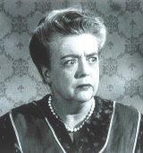
C.A.S.A.

Slide 20
CASA’S ROLE:
The CASA /Child Advocate should advocate for the best interests of the children served by Family Treatment Court at staffings and hearings and participate as an active, engaged member of the Family Treatment Court team.

Slide 21
D.F.C.S. REPRESENTATIVE

Slide 22
DFCS REPRESENTATIVE’S ROLE:
to protect children’s health and safety;
ensure the well-being of the children;
ensure that children and their parents receive necessary services in addition to substance abuse treatment;
assist in identifying potential participants and refer them to Family Treatment Court;
inform the team immediately of any significant changes in the needs of children and parents;
and attend and participate as an active, engaged member of the Family Treatment Court team in all staffings and required hearings.

Slide 23
TREATMENT PROVIDER

Slide 24
TREATMENT PROVIDER’S ROLE:
to provide the parent with the appropriate level of substance abuse treatment as determined after evaluation and assessment;
bring physical/mental health treatment needs of the parent to the attention of the Family Treatment Court team;
provide services to address parents’ needs or make appropriate referrals for services;
provide weekly progress notes to the Family Treatment Court each week in a timely manner;
provide random, observed drug and alcohol testing;
and to provide a discharge plan for the parent and all parties involved.
Remember that it is the Judge’s responsibility to ensure treatment provider is providing treatment in fidelity with the model

Slide 25
COMMUNITY POLICING

Slide 26
COMMUNITY POLICING/ SURVEILLANCE OFFICER’S ROLE
report observations made during random home visits;
report observations regarding the children and the home environment;
conduct random, observed drug screens;
and report results of drug tests and any other information deemed relevant to the family’s continued success.
Attend staffing and court and participate as team member

Slide 27
How Do You Get Started?
Recruit your team
Gather Community Support
Conduct Planning Meetings to Develop:
Policy and Procedure Manual
Participant Handbook
Sanction / Incentive Matrix
Treatment Curriculum
Target Population/Intake Procedures
Apply to the CACJ for Certification and Implementation Grants/Funding

Slide 28
MARKETING
FAMILY TREATMENT COURT HAS THE ADVANTAGE

Slide 29
Family Treatment Courts – How can anyone say NO?

Slide 30
FTCs – PROTECT CHILDREN

Slide 31
FTCs – TREAT THE WHOLE FAMILY

Slide 32
FTCs – results
Nationwide research shows that FTCs have expedited entry into substance abuse treatment and improved completion rates, as well as faster reunification and a lower rate of return to care.
Between January 1, 2014-June 30, 2016, the 9 Georgia FTCs served 555 parents and 830 children.
During that time period, average graduation rate was 47% and retention rate was 71%, higher than the national rate of 35% and 48% respectively.
The median FTC time to reunification is approximately 6 months with 95 children having been reunified in the first 6 months of 2016.

Slide 33
CHALLENGES
REFERRALS
CSB SUPPORT AND INVOLVEMENT
TIME
LOCAL GOVERNMENT
EDUCATION

Slide 34
REFERRALS
Department of Family and Children Services
Main referrer
Must be an active member of your team
Have to change their mindset
Consistency in case workers may be a challenge
How do you motivate somebody that doesn’t directly report to you?
Adult Criminal Division
Educate DA, PD, Private Attorneys
Transfers from Superior Court/State Court/Other accountability courts

Slide 35
COMMUNITY SERVICE BOARD INVOLVEMENT
Often is main/only service provider
Need consistency in treatment
Evidence based treatment
Parents and Children
Insurance/billing can be a barrier to treatment
Must be a member of your team
Communication with team
Attendance in Staffing and Court
Timely updates are crucial

Slide 36
TIME
Judge time is the critical factor
Court and staffing every other week at a minimum
Time for Break for attorneys and participants
3 minutes per participant
Planning & Policy Development
Activities
Community education
Continuing education
Miscellaneous: emails, discussion, problem solving for quick responses

Slide 37
SCHEDULE
COURT TIME - ALL
STAFFING TIME - TEAM
TREATMENT TIME - PARTICIPANTS, KIDS AND TREATMENT
OUTSIDE MEETINGS – PARTICIPANTS
VISITATION – PARTICIPANTS AND KIDS
PLANNING TIME – TEAM
CONTINUING EDUCATION - TEAM

Slide 38
LOCAL GOVERNMENT
FUNDING
Grant funds require a 10% match
Facilities
Courtroom space
Staff/Meeting
COOPERATION
Sheriff
Judges
Prosecutors
Your staff

Slide 39
EDUCATION
YOU
STAFF
TEAM
LOCAL GOVERNMENT
BAR
PUBLIC

Slide 40
Things to Consider

Slide 41
DRUG SCREENS
FREQUENT – 2 to 3 times per week
RANDOM – Color system, Call –to-test, etc.
OPPORTUNITY TO ADMIT- before test
OBSERVED – same sex observer
URINE SCREENS – need facilities
RESULTS – need fairly rapid results
CONFIRMATION – need ability to confirm positives
CREATININE AND SUBSTANCES
http://ndcrc.org/sites/default/files/pdf_creatinine_webinar_7.5.11.pdf

Slide 42
SANCTIONS
Graduated Sanctions – progressively worse
Don’t start immediately with jail time
Proximal v. Distal Goals – relapsing disease
Progress not Perfection
Be Creative:
Broom Awards
Community Service
Write a Paper
Jail Sanctions
Sanctions are different from Treatment Responses
Can also include staying until the end of Court
WITHOLDING VISITATION IS NOT A SANCTION!

Slide 43
Sample Sanction Matrix
 | Admits use prior to being confronted by staff. (Must admit w/in 24 hrs. of use) | Positive Screen (Does not admit prior to being confronted by staff) | Contests Validity of positive screen and requests confirmation; Screen confirms positive (Dishonesty about use) | Dilute or provides urine sample with Abnormal result and denies intentional tampering. | Substitution or Adulteration: Attempts to substitute or alter urine sample (Contract Violation)
1St Offense | Treatment Response | 8 hours CSW | 3 night jail | Sign Notice of Dilute/Abnormal Screen (If admit, treat as positive) | 30 days in custody
2nd Offense | 8 hours CSW | 1 night jail | 6 nights jail | Sign 2nd Notice of Dilute/Abnormal Screen; 2 weeks daily testing; See physician (If admit, treat as positive) | Termination
3rd Offense | 1 nights jail | 3 nights jail | 10 nights jail | Treated as Positive Screen, 1st Offense for Column B.
4th Offense | 3 nights jail | 5 nights jail | 14 nights jail | Treated as Positive Screen, 2nd Offense for Column B.
Phase Impact | Phase Freeze for 30 days from date of use | Phase Freeze for 30 days from date of use | Phase Freeze for 30 days from date of use | Phase Freeze 30 days from date of use once treated as positive

Slide 44
INCENTIVES
More Important than Sanctions
Be Creative:
Monetary Awards (gift cards, gas cards, groceries)
Fishbowl, Wheel, Lottery
Certificates – Star Awards, MRT Certificates
Cards – Birthday, New Job, Front of the Line
Incentive Basket- candy, small treats for kids, toiletries
Praise, Praise, Praise!

Slide 45
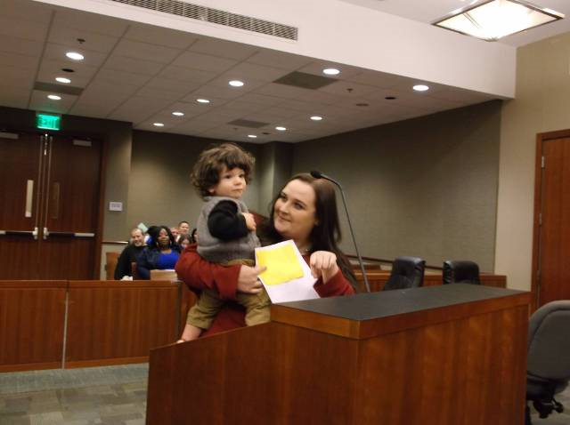
Family Treatment Courts – the best for parents and kids

Slide 46
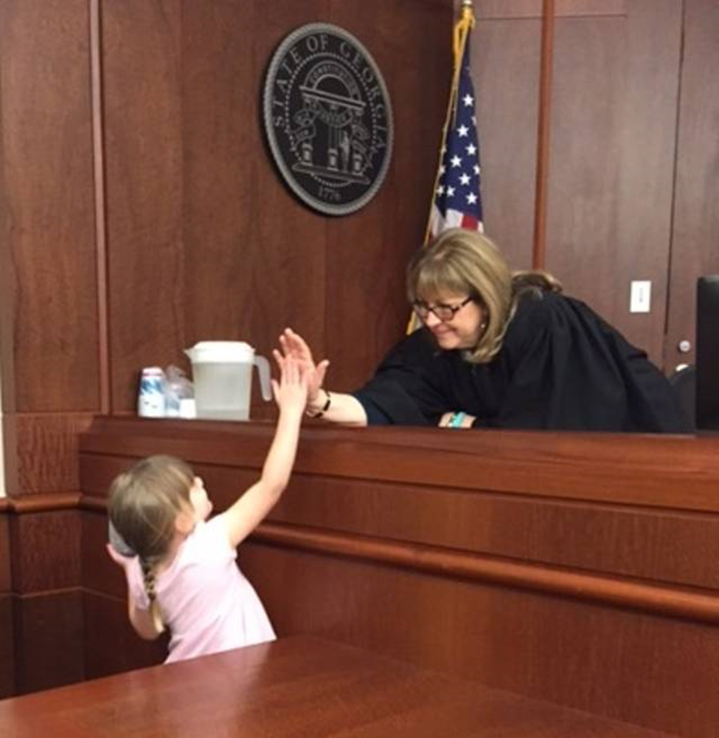

Slide 47
QUESTIONS?
Taylor Jones, Executive Director, CACJ
Taylor.jones@georgiacourts.gov
(404)463-1453
Josh Becker, Chief Certification Officer
Josh.becker@georgiacourts.gov
(404)463-6298
Judge Philip B. Spivey
spiveyp@eighthdistrict.org
(478) 445-7060 (office); (478) 454-7558 (cell)
Judge Alison W. Toller
atoller@hallcounty.org
(770) 532-6928

Slide 48
Resources
www.gaaccountabilitycourts.org
http://www.fdctutorials.org/tu/
http://ndcrc.org/sites/default/files/pdf_creatinine_webinar_7.5.11.pdf

