Slide 1
Mobilizing State and Federal Resources to Support Your Courts
Georgia Accountability Court Conference

Slide 2
Welcome and Introductions
Sarah Wurzburg, Deputy Program Director, Behavioral Health, the Council of State Governments Justice Center
Taylor Jones, Executive Director, Council of Accountability Court Judges
Notes:
Bonnie welcomes audience
Intro to webinar concept
Intro to speakers
Bonnie passes to Rise and Will

Slide 3
Federal and State Funding
Federal Funding
Sustainability Tips
State Funding
Question & Answer

Slide 4

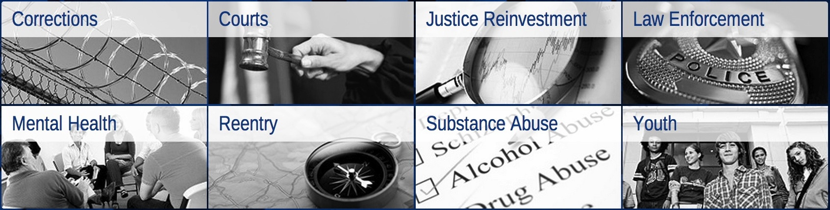
National non-profit, non-partisan membership association of state government officials
Engages members of all three branches of state government
Justice Center provides practical, nonpartisan advice informed by the best available evidence

Slide 5
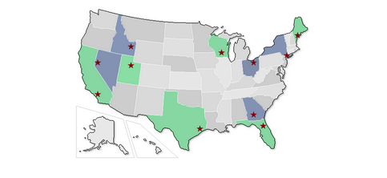
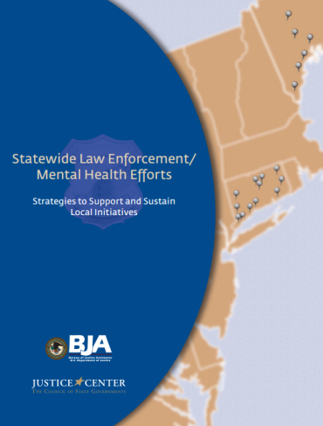
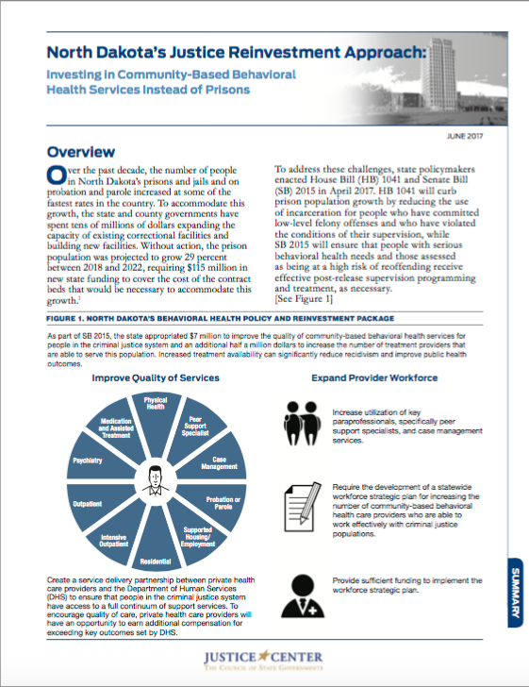



Behavioral Health at the
CSG Justice Center
Criminal Justice/Mental Health Learning Sites Program
Notes:
Sheila

Slide 6

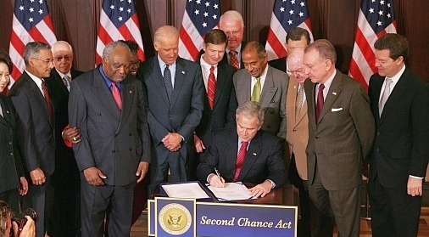
Authorized by the passage of the Second Chance Act in April 2008
Launched by the Council of State Governments in October 2009
Administered in partnership with the Bureau of Justice Assistance, U.S. Department of Justice
The NRRC has provided technical assistance to over 600 juvenile and adult reentry grantees since inception
Notes:
The National Reentry Resource Center is the technical assistance provider for all Second Chance Act grantees, and has been since the passage of the Second Chance Act in April 2008.
In partnership with the US Dept. of Justice’s Bureau of Justice Assistance, CSG Justice Center launched the NRRC and since 2009, has provided technical assistance to over 600 juvenile and adult reentry grantees.

Slide 7
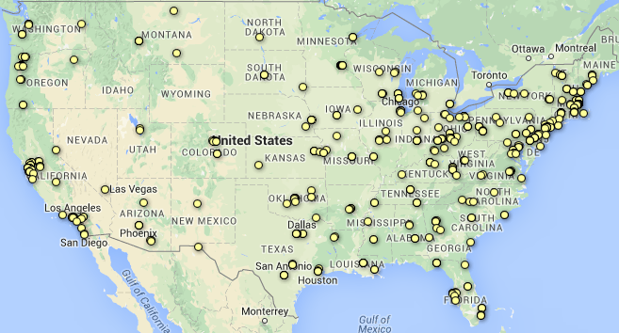
The Second Chance Act Grantees

Slide 8
The National Reentry Resource Center
The NRRC is a project of the CSG Justice Center and is supported by the Bureau of Justice Assistance
csgjusticecenter.org/nrrc
Provide a one-stop, interactive source of current, user-friendly reentry information.
The NRRC provides individualized, intensive, and targeted technical assistance, training, and distance learning to support SCA grantees.
  Please register for the monthly NRRC newsletter at:
  csgjusticecenter.org/subscribe/
  Please share this link with others in your networks that are interested in reentry!
Council of State Governments Justice Center
Notes:
Identify, document, and promote evidence-based practices.
Advance the reentry field through training, distance learning, and knowledge development.
Deliver individualized, targeted technical assistance to the Second Chance Act grantees.

Slide 9
SCA Grant Programs
SMART Reentry
Mentoring Grants
Co-occurring Substance Use and Mental Disorders Treatment Grants
State Recidivism Reduction Grants
SMART Probation Grants
Notes:
Demonstration grants provide funding to state and local government agencies and federally recognized Indian tribes to plan and implement comprehensive strategies that address the challenges faced by adults and youth returning to their communities after incarceration. Click here to learn more about the demonstration grant program.
Mentoring grants support nonprofit organizations and federally recognized Indian tribes that provide mentoring, case management, and other transitional services. Click here to learn more about the mentoring grant program.
Co-occurring treatment grants provide funding to state and local government agencies and federally recognized Indian tribes to implement or expand integrated treatment programs for individuals with co-occurring substance abuse and mental health disorders. Click here to learn more about the co-occurring treatment grant program.
Technology career training grants help state and local government agencies and federally recognized Indian tribes to establish programs to train individuals in prisons, jails, or juvenile residential facilities for technology-based jobs and careers during the three-year period before their release. Click here to learn more about the technology career training grant program.
Recidivism reduction grants provide funding to state departments of correction to achieve reductions in recidivism rates through planning, capacity-building, and implementation of effective and evidence-based interventions. Click here to learn more about the recidivism reduction grant program.
Smart Probation grants provide funding to state and local government agencies and federally recognized Indian tribes to implement evidence-based supervision strategies to improve outcomes for probationers. Click here to learn more about the smart probation grant program.

Slide 10
BJA FY 2015 Second Chance Act Reentry Program for Adults with Co-Occurring Substance Abuse and Mental Health Disorders
Notes:
Working with RSAT program:
Essex County
Bristol County

Slide 11
Purpose of Section 201
The purpose of Section 201 of the Second Chance Act is to:
develop and implement comprehensive and collaborative strategies to increase public safety and reduce recidivism among reentering adults.
improve the provision of drug treatment to adults in secure confinement facilities.
reduce long-term substance abusers’ use of alcohol and other drugs while they are in a secure confinement facility and through the completion of parole or court supervision.

Slide 12
Purpose of the SCA Co-occurring Disorders Grant Program
Goal
Reduce recidivism and improve public safety and public health by providing screening, assessment, and pre- and post-release treatment for individuals with co- occurring substance use and mental disorders.
Objectives
Increase the screening and assessment for criminogenic risk and needs, substance use, and mental disorders in jails and prisons.
Improve the provision of integrated treatment to adults with co-occurring substance use and mental disorders pre- and post-release from incarceration.
Develop reentry case plans that incorporate the results for risk and needs assessment, substance use disorders, and mental disorders to develop supervision and program components.
Notes:
The Reentry Program for Adults with Co-Occurring Substance Use and Mental Disorders is designed to improve outcomes for adults with co-occurring substance use and mental disorders returning to communities after a period of incarceration. BJA recognizes that a significant number of individuals who are incarcerated and return to the community have chronic substance use and mental disorders and are in need of treatment in order to successfully complete their supervision, reduce recidivism, and promote public safety. The coordination of substance use and mental health treatment with correctional planning can encourage participation in treatment and can help incorporate treatment goals into correctional supervision and supports.
Under this solicitation, BJA is seeking applications to implement or expand treatment programs for adults with co-occurring substance use and mental disorders who are returning to their communities following incarceration. Programs should expand and improve the screening and assessment for co-occurring disorders that takes place in jails and prisons, in-reach by community-based providers, and the reentry and community reintegration process. Proposed programs should improve the provision of treatment for adults (18 years and over) being treated for co-occurring substance use and mental disorders, focusing on pre- and post-release programming for every program participant.

Slide 13
Co-Occurring Disorders Program Expectations
Planning Phase
      Grantees will use the P&I Guide to develop a strategic plan that incorporates evidence-based programs, policies, and practices
Implementation Phase
Grantees will focus on:
      Meeting their target population
      Implementing screening & assessment
      Implementing treatment services pre- and post-release
      Collaborating between criminal justice and behavioral health partners
Notes:
Planning Phase: The P&I Guide will guide each grantee in developing a strategic plan that incorporates evidence-based programs, policies, and practices.
Implementation Phase: Grantees will focus on meeting their target population through the implementation of screening, assessment, and co-occurring substance use and mental disorders treatment services pre- and post-release for every program participant. This will involve collaboration between criminal justice and behavioral health partners.

Slide 14
Justice and Mental Health Collaboration Program Funding
Mentally Ill Offender Treatment and Crime Reduction Act Public Law 108-414 signed into law in 2004 with bipartisan support
Authorized JMHCP: $50 million for criminal justice-mental health initiatives
Reauthorized for five years in 2008 (Public Law 108-416)
December 2016 the 21st Century Cures Act provided funding for JMHCP and MH Courts
Notes:
Through JMHCP, BJA has awarded $57 million in grants to more than 300 recipients in 49 states and territories. Picture is of Houston PD visit to Arizona to provide CIT training—Houston PD is a JMHCP learning site.
Purpose:
Help states, local government, and tribal organizations improve responses to people with mental disorders who are involved with the criminal justice system
Facilitates collaboration among the criminal justice, juvenile justice, and mental health and substance use treatment systems
CURES Act:
Included in the omnibus bill’s range of initiatives are several criminal justice reform measures related to the issue of mental health, including the enactment of the Comprehensive Justice and Mental Health Act (CJMHA) and the reauthorization of the Mentally Ill Offender Treatment and Crime Reduction Act (MIOTCRA). The bill is a milestone in the fight to address mental illness and substance use disorders in the criminal justice system.

Slide 15
JMHCP Grantee Categories

Slide 16
What does the JMHCP fund?
Training and technical assistance
Grant programs serving adults
Grant programs impacting statewide policy and practice
Grant programs serving juveniles

Slide 17
New Focus: Diversion &
Systems Planning
For FY 2017, BJA has revised the goals of JMHCP to:
  increase early identification and front-end diversion of people with mental health and co-occurring substance use disorders identified at early intercept points within the justice system.
  move away from facilitating small-scale programming, which meets the needs of a limited target population, and move toward support for systemic reviews and changes.
This will allow state, local, and tribal justice systems to more comprehensively respond to people with mental illnesses and co-occurring substance use disorders
Notes:
This program seeks to increase the number of justice, mental health, and community partnerships; increase evidence-based practices and treatment responses to people with behavioral health disorders in the justice system; and increase the collection of health and justice data to accurately respond to the prevalence of justice-involved people with mental health and co-occurring substance use disorders.
Planning for systems level change including new micro-grants for law enforcement agencies
How did we get to this new focus?

Slide 18
Court-Based Program Requirements
In determining eligibility, the relevant prosecuting attorney, defense attorney, probation or corrections official, judge, and mental health or substance abuse agency representative shall take into account:
  (1) whether the participation of the defendant in the program would pose a substantial risk of violence to the community
  (2) the criminal history of the defendant and the nature and severity of the offense for which the defendant is charged,
  (3) the views of any relevant victims to the offense,
  (4) the extent to which the defendant would benefit from participation in the program,
  (5) the extent to which the community would realize cost savings because of the defendant's participation in the program, and
  (6) whether the defendant satisfies the eligibility criteria for program participation unanimously established by the relevant prosecuting attorney, defense attorney, probation or corrections official, judge and mental health or substance abuse agency representative.
Notes:
For court-based programs, in addition to the requirements listed above, in determining a defendant’s eligibility for participation in a program funded under this solicitation, the relevant prosecuting attorney, defense attorney, probation or corrections official, judge, and mental health or substance abuse agency representative shall take into account the following considerations (1) whether the participation of the defendant in the program would pose a substantial risk of violence to the community ^{[1]} (2) the criminal history of the defendant and the nature and severity of the offense for which the defendant is charged, (3) the views of any relevant victims to the offense, (4) the extent to which the defendant would benefit from participation in the program, (5) the extent to which the community would realize cost savings because of the defendant's participation in the program, and (6) whether the defendant satisfies the eligibility criteria for program participation unanimously established by the relevant prosecuting attorney, defense attorney, probation or corrections official, judge and mental health or substance abuse agency representative.
All programs should have clear and transparent eligibility requirements and accept any individual who meets those requirements after they have been screened for criminogenic risk and mental health need.
Applicants may review Pub. L. 108-414 and Pub. L. 110-416 for supporting information related to this solicitation.

Slide 19
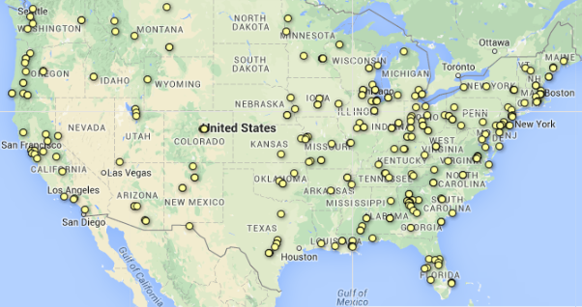
The JMHCP Grantees

Slide 20
JMHCP Categories
Category 1: Collaborative County Approaches to Reducing the Prevalence of Individuals with Mental Disorders in Jail
Category 2: Strategic Planning for Law Enforcement and Mental Health Collaboration
Category 3: Implementation & Expansion
Notes:
CATEGORY 1: COLLABORATIVE COUNTY APPROACHES TO REDUCING THE PREVALENCE OF INDIVIDUALS WITH MENTAL DISORDERS IN JAIL. Grant amount: Up to $150,000. Project period: 24 months.
CATEGORY 2: PLANNING AND IMPLEMENTATION. Grant amount: Up to $250,000. Project period: 36 months.
CATEGORY 3: EXPANSION. Grant amount: Up to $200,000. Project period: 24 months.

Slide 21
Grant Categories
Category 1: Collaborative County Approaches to Reducing the Prevalence of Individuals with Mental Disorders in Jail: grantees will demonstrate a systemwide coordinated approach to safely reduce the prevalence of individuals with mental disorders in local jails.
  Grant Amount: Up to $200,000, Project Period: 24 months
Category 2: Strategic Planning for Law Enforcement and Mental Health Collaboration: grantees will design their community’s law enforcement mental health collaboration strategy to improve responses to, and connections to services for, people with mental health and co-occurring disorders by conducting a comprehensive agency assessment of policy and practice, developing an agency training plan, building and maintaining a data collection system, and partnering with mental health and the community.
  Grant Amount: Up to $75,000, Project Period: 12 months
Category 3: Implementation and Expansion: grantees will implement targeted mental health and justice system interventions to address the needs of individuals with mental disorders or expand upon (or improve) well-established mental health and justice system collaboration strategies to address the needs of individuals with mental health disorders and to improve public safety.
  Grant Amount: Up to $300,000, Project Period: 24 months
Notes:
CATEGORY 1: COLLABORATIVE COUNTY APPROACHES TO REDUCING THE PREVALENCE OF INDIVIDUALS WITH MENTAL DISORDERS IN JAIL. Grant amount: Up to $200,000. Project period: 24 months. Competition ID: BJA-2017-11381
CATEGORY 2: STRATEGIC PLANNING FOR LAW ENFORCEMENT AND MENTAL HEALTH COLLABORATION. GRANT AMOUNT Up to $75,000. Project period: 12 months. Competition ID: BJA-2017-11382
CATEGORY 3: IMPLEMENTATION AND EXPANSION. GRANT AMOUNT Up to $300,000. Project period 24 months. Competition ID: BJA-2017-12123

Slide 22
Category 3: Implementation and Expansion
Implement an already initiated plan or expand upon (or improve) a well-established collaboration plan between justice and mental health partners.
grants can support law enforcement response programs; court-based initiatives such as mental health courts, pretrial services, and diversion/alternative prosecution and sentencing programs; treatment accountability services; specialized training for justice and treatment professionals; corrections/community corrections initiatives; transitional and reentry services; treatment; and non-treatment recovery support services coordination and delivery including case management, housing placement and supportive housing, job training and placement, education, primary and mental health care, and family supportive services.
Notes:
Any of the following examples of allowable uses of grant funds may be combined with one another, or may be combined with an evaluation component, which would receive priority consideration (see “Priority Considerations” section). Grantees will receive technical assistance through written guidance and review of their implementation/expansion strategy. They will be required to complete and submit a Planning and Implementation Guide4 (to be provided by the BJA TTA provider) that reflects the program being implemented.

Slide 23
Planning & Implementation Guide
Grantees will receive intensive technical assistance and access up to $100,000 of the total grant award in order to complete and submit a required P&I Guide
Program budget approval and coordination with a technical assistance coordinator is required to complete and submit a Planning and Implementation Guide.
Law enforcement agencies that apply under Category 3 must demonstrate a track record of collaboration or partnership with community mental health agencies.
Notes:
Completion and Submission of the Planning and Implementation Guide
Grantees will receive intensive technical assistance and will be allowed to access up to $100,000 of the total grant award in order to complete and submit a required Planning and Implementation Guide provided by the BJA TTA provider, which will guide each grantee in developing a strategic plan that incorporates evidence-based programs, policies, and practices. Program budget approval and coordination with a technical assistance coordinator is required to complete and submit a Planning and Implementation Guide.
Law enforcement agencies that apply under Category 3 must demonstrate a track record of collaboration or partnership with community mental health agencies.
Law enforcement applicants must demonstrate in the narrative:
A written action plan describing areas needing improvement or enhancement based on a comprehensive review/assessment.
An executed memorandum of understanding or other similar written agreement between the law enforcement agency and one or more behavioral health partners outlining the terms of their partnership and collaboration.
A description of training curricula and in-service training regarding behavioral health.
A letter or document indicating the commitment of leadership from the law enforcement agency and/or local officials to carry out this plan.
The availability of data and capacity to measure:
o Numberorratesofarrestamongpeoplewithmentalhealthneeds/co-occurring
disorders.
o Diversionfromjailforpeoplewithmentalhealthneeds/co-occurringdisorders.
o Referralsorhand-offsofpeoplewithmentalhealthneeds/co-occurringdisorders
to behavioral health or services providers.
o Numberorrateofincidentsinvolvingtheuseofforceinvolvingpeoplewith
mental health needs/co-occurring disorders.
o Numberorratesofinjuriestoofficersorcitizensforincidentsinvolvingpeople
with mental health needs/co-occurring disorders.

Slide 24
Category 3: Allowable Uses
Training for criminal justice, mental health, and substance use treatment personnel
Enhance Access to Community-Based Healthcare Services and Coverage
Law Enforcement Responses
Diversion and Alternative Sentencing
Correctional Facility Grants
Community Supervision Strategies
Case Management and Direct Services
Notes:
Please refer to slide 18 for additional requirements for court-based programs

Slide 25
Implementation Phase and Expansion (Category 2 and 3)
Law Enforcement Responses (a Priority Consideration)
Training for criminal justice, mental health and substance use treatment personnel
Enhance Access to Community-Based Healthcare Services and Coverage
Community Supervision Strategies
Diversion and Alternative Sentencing
Case Management and Direct Services
Notes:
b. Cross-system training programs for corrections-based staff, courts personnel, community supervision personnel, and community-based mental health and substance use providers.
Training areas may include behavioral health and criminogenic risk and needs, case management, trauma-informed care, crisis- responses, integrated treatment and supervision strategies, and improving access to
treatment and supportive services.

Slide 26
References for Applicants
Program Evaluation
Risk-Need-Responsivity Principle
Screening and Assessment Tools
Providing Interventions that Address Criminogenic Need
Mental Health Treatment Services
Housing, Supported Employment, and Supported Education
Notes:
Program Evaluation
Program Evaluation is critical to the effectiveness and utility of JMHCP programs, as evaluation not only determines which programs are most effective for which populations, but also contributes toward the expansion of the knowledge base of what programs have the highest likelihood for success in lowering recidivism and improving public health outcomes. BJA strongly urges applicants to consider a partnership with a local research organization that can assist with data collection, performance measurement, and local evaluation. One resource that applicants may be interested in using is the e-Consortium for University Centers and Researchers for Partnership with Justice Practitioners. The purpose of this e-Consortium is to provide a resource to local, state, federal, and other groups who seek to connect to nearby (or other) university researchers and centers on partnerships and projects that are mutually beneficial to the criminal justice community. The e-Consortium can be found online at www.gmuconsortium.org.
Risk-Need-Responsivity Principle
Current research supports the “Risk-Need-Responsivity” (RNR) model for how criminal justice authorities should be identifying and prioritizing individuals to receive appropriate interventions6. BJA intends to fund programs that have a demonstrated evidence base and that are appropriate for the target population. Applicants should incorporate the following evidence-based practices in the development or enhancement of their client-based programs:
1. Screening and Assessment Tools
Use validated screening and assessment tools that have a demonstrated evidence base and that are appropriate for the target population.
Screening and Assessment Resources:
• Screening and Assessment of Co-Occurring Disorders in the Justice System—Provides an overview of screening and assessment of persons with co-occurring disorders involved in the criminal justice system and includes an extensive list of screening and assessment instruments for different target populations.
6 See The Council of State Governments Justice Center, “Adults with Behavioral Health Needs under Correctional Supervision: A Shared Framework for Reducing Recidivism and Promoting Recovery” available at www.csgjusticecenter.org/mental-health-projects/behavioral-health-framework/ for a thorough discussion of the RNR principle and how it should be applied to the justice-involved population with mental disorders.
Mental Health Screening within Juvenile Justice: The Next Frontier—Provides an overview of new issues and offers policy clarification on mental health screening in the juvenile justice system.
Brief Jail Mental Health Screen—Booking tool developed by the University of Maryland School of Medicine and Policy Research Associates to screen incoming detainees in jails and detention centers for the need for further mental health assessment.
Providing Interventions that Address Criminogenic Need
Tailor treatment interventions to individuals’ specific criminogenic and behavioral health needs to improve public safety and public health outcomes. Criminogenic needs are risk factors closely associated with offending behavior and to which targeted interventions are responsive. Criminogenic risk and needs factors include history of anti-social behavior, anti- social personality pattern, anti-social cognition, anti-social associates, unsupportive relationships with family and/or spouse, especially in regard to refraining from criminal activity, underperforming and lacking motivation in school and/or work, lacking in non- criminal leisure and/or recreation activities, and substance use.
Mental Health Treatment Services
Provide mental health treatment practices that have a demonstrated evidence base and that are appropriate for the target population. The following evidence-based mental health treatment practices have been shown to improve clinical outcomes for people with serious mental illnesses:
Assertive Community Treatment (ACT)
Illness Management and Recovery (IMR)
Integrated Mental Health and Substance Abuse Services
Supported Employment (SE)
Psychopharmacology
Other promising practices:
Forensic ACT (FACT)
Cognitive Behavioral Therapy (CBT)
Applicants can also find information on evidence-based practices in the Substance Abuse and Mental Health Services Administration’s (SAMHSA) Guide to Evidence-Based Practices available at www.samhsa.gov/ebpwebguide. The Guide provides a short description and a link to dozens of websites with relevant evidence-based practices information—either specific interventions or comprehensive reviews of research findings. Please note that SAMHSA’s Guide to Evidence-Based Practices also references the National Registry of Evidence-Based Programs and Practices (NREPP), a searchable database of interventions for the prevention and treatment of mental and substance use disorders. NREPP is intended to serve as a decision support tool, not as an authoritative list of effective interventions. Being included in NREPP, or in any other resource listed in the Guide, does not mean an intervention is “recommended” or that it has been demonstrated to achieve positive results in all circumstances. Applicants must document that the selected practice is appropriate for the specific target population and purposes of your project.
4. Housing, Supported Employment, and Supported Education
Utilize other evidence-based practices based on the needs of the target population. Supported Employment is an evidence-based practice that is designed to help the individual find and keep competitive work. Housing programs for persons with mental illness should take into consideration the demands of the criminal justice system and ensure that a range of options are available. Supported Education interventions have also been found to be a promising practice. The Center for Psychiatric Rehabilitation at Boston University has developed the Higher Education Support Toolkit that can be used as a resource.

Slide 27
Priority Considerations
For Category 1: Large Urban Counties or Rural Counties in Partnership with Neighboring Counties or States
For Category 1: Counties with a Demonstrated Commitment to Reducing the Prevalence of People with Mental Illness in Jail
Program Evaluation
Provision of Services for Justice System-Involved Females
Information sharing between criminal justice agencies and community behavioral health services
Notes:
Services Provision Considerations
TIC
CODs

Slide 28
Target Population Requirements
Grant funds must be used to support a target population that includes adults or juveniles who:
  Have been diagnosed as having a mental illness or co-occurring mental health and substance abuse disorders; and
  Have faced, are facing, or could face criminal charges for a misdemeanor or felony that is a nonviolent offense.
  An individual’s past criminal history has no effect on present eligibility for JMHCP programs.
  Applicants may review Pub. L. 108-414 and Pub. L. 110-416 for supporting information related to this solicitation.

Slide 29
Adult Drug Court Discretionary
Grant Program
PURPOSE: To establish or enhance Drug Courts and systems for nonviolent substance-abusing offenders. For the purposes of this solicitation, the definition of "Adult Drug Court" may include Driving While Intoxicated (DWI)/Driving Under the Influence (DUI) Courts, Co-Occurring Drug and Mental Health Courts, Veterans' Treatment Courts, and Community Courts.
WHO CAN APPLY: For Implementation and Single Jurisdiction Enhancement Grants, applicants are limited to states, state and local courts, counties, units of local government, and federally-recognized Indian tribal governments; Indian tribal governments may apply directly or through other public or not-for-profit private entities. For Statewide Grants, applicants are limited to state agencies such as the State Administering Agency (SAA), the Administrative Office of the Court, or the state Alcohol and Substance Abuse Agency.

Slide 30
Enhancing Adult Drug Court Services, Coordination, and Treatment
URPOSE: To enhance Drug Court capacity, allowing applicants to compete for access to both criminal justice and substance abuse treatment funds with one application. In order to fulfill all of the requirements for this grant program, applicants must comply with the requirements outlined in the grant announcement as well as those, incorporated by reference, in the Requirements Resource Guide.
For the purposes of this solicitation, the definition of "Adult Drug Court" shall include Driving While Intoxicated (DWI)/Driving Under the Influence (DUI) Courts, Co-Occurring Drug and Mental Health Courts, Veterans' Treatment Courts, and Community Courts that serve substance-abusing adults in the respective problem-solving court, as long as the court meets all the elements required for Drug Courts.
Under this program, grantees will receive two separate awards; BJA will fund the Drug Court component and the Center for Substance Abuse Treatment (CSAT) will fund the substance abuse treatment component. Please note that BJA will make a one-time award, up to $300,000 (match is required) per grantee, for the entire 3-year grant period, while CSAT will make annual awards, up to $325,000 per grantee, for each year of the 3-year grant period.
WHO CAN APPLY: Applicants are limited to states, state courts, local courts, counties, other units of local government, or Indian tribal governments (as defined under the Indian Self Determination Act, 25 U.S.C. 450b(e)); Indian tribal governments may apply directly or through other public or not-for-profit private entities.

Slide 31
Juvenile Treatment Drug Courts
PURPOSE: To expand and enhance substance abuse treatment services in “problem solving” courts which use the juvenile drug court model in order to provide alcohol and drug treatment, recovery support services and program coordination to juvenile defendants/defenders.
It is expected that up to 27 grants will be awarded for up to three years. The average annual award amount for each grantee is expected to be up to $325,000. The actual award amounts may vary, depending on the availability of funds and the progress made by the grantees.
WHO CAN APPLY: Eligibility is restricted to existing individual juvenile drug courts that have demonstrated relationships and agreements with existing domestic public and private nonprofit entities and community-based treatment providers and units of tribal, state and local governments that submit applications on behalf of an individual Juvenile Treatment Drug Courts.

Slide 32
Family Treatment Drug Court
PURPOSE: The purpose of this program is to expand and/or enhance substance use disorder treatment services in existing family treatment drug courts, which use the family treatment drug court model in order to provide alcohol and drug treatment (including recovery support services, screening, assessment, case management, and program coordination) to parents with a substance use disorder and/or co-occurring substance use and mental disorders who have had a dependency petition filed against them or are at risk of such filing.

Slide 33
Federal and State Funding
Federal Funding
Sustainability Tips
State Funding
Question & Answer
Notes:
Rise finishes section,
Bonnie thanks Rise and Will
Bonnie intros how we can see these issues alive and well in the field.
I’d like to now introduce a Justice and Mental Health Grantee, Suzanne Watson of Pottawamie County, Iowa. She is the CEO SWIA MHDS Region and the Pottawattamie County Community Services Director
Suzanne Watson has worked in the Mental Health and Disability Services field for 25 years beginning as a direct service provider and case manager. She has filled the role of Community Services Director for Pottawattamie County since 1999 and in 2014 transitioned to the position of CEO of the Southwest Iowa MHDS Region which is made up of nine counties in Southwest Iowa.
Suzanne received her Bachelor’s Degree in Social Work from the University of Iowa and a Masters in Social Work from the University of Nebraska at Omaha. She enjoys the opportunities and challenges that have come with the transition from a county-based to a regional system in Iowa along with the changes in funding streams, insurance, laws and administrative code.

Slide 34
The Secrets of Sustainability
Staying attuned to shifting trends and working on maintaining your program, as well as improving it
Involving your entire program/intervention team
Main objectives:
  Clearly defining your program’s goals and mission
  Involving key stakeholders and finding a champion
  Building cross-agency collaborations
  Collecting “data” to make the case for sustaining the program over the long-term
  Marketing your program
  Identifying potential funding streams
Notes:
Stakeholder’s priorities will change over the life of your program. To effectively manage this, it is important (see above)
Ensuring that your program remains both sustained and worthy of being sustained requires the careful attention of all of the mental health court team members and members of the program’s advisory group.
The programs we see that are successful have multiple sources of funding: blending state, federal and foundation funding, entitlements and discretionary funding from multiple sources
Relying on grants alone – federal particularly doesn’t assure long-lasting sustainability
Also, plan and collect data early, early, early. Revisit and revise the plan frequently, and ensure strong leadership (with both your internal and external stakeholders).

Slide 35
Effective Leadership
Is leadership committed to long‐term involvement with the program?
Is there support from key stakeholders in the community and among relevant agencies and providers?
Is there a champion who can publicly advocate for the continuation of the program?
Source: Skowyra, K. R., Cocozza, J. J., & Shufelt, J. L. (2010).
Notes:
A strong leader and the involvement of key stakeholders help to the build broad support necessary for the continuation of programs.
Frequent champions of many of these programs are a local Judge or politician that recognizes the need in their community:
JMHCs – of 41 programs around the country for example, all of them were started or initiated by a Judge or Politician. No exceptions.

Slide 36
Cross-Agency System Collaboration
Are the relevant treatment and justice agencies involved with collaborating on the program?
Are there formal interagency agreements in place that can be used as building blocks for maintaining the program?
Are collaborators adequately involved in program design, implementation, and evaluation?
Are there opportunities to integrate the program into other key program areas already in place in other agencies?
Source: Skowyra, K. R., Cocozza, J. J., & Shufelt, J. L. (2010).
Notes:
Given the fact that the systems targets and serves individuals in contact with the justice system, a broad base of support is necessary.
Department of mental health, community corrections: probation and parole, discharge planners from facilities, intake departments in facilities
Do you have MOUs w/ them
Have you invited them to the table to actual meetings
Can you utilize community corrections for example to help w/ supervision and case management? Can officers maybe switch case loads to have a specialized MH case load

Slide 37
Partner with Behavioral Health Provider
Partnership with behavioral health providers are key to specialty courts success
Work with the behavioral health provider to find out about whether they assist in enrollment in benefits
Is insurance enrollment something that fits within the scope of your court?
If not, what other resources are available to help people get access to BH services in the community?

Slide 38
Connections to Healthcare and
Other Benefits
90% of jail admissions have no health care
(Wang, 2008)
Legal Action Center Resources:
State Profiles of Health Care Information for the Criminal Justice System
Restoring Medicaid Upon Release from Prison

Slide 39
Enrollment in Public Health Insurance in Georgia
Health Insurance Exchange Information: Georgia has a Federally-facilitated Marketplace (FFM).^{[iii]} People can use the FFM to compare plans, purchase low-cost insurance, and take advantage of federal tax subsidies that apply.
Eligibility and Enrollment: People can apply for and enroll in Medicaid or CHIP any time of year and coverage can begin immediately. They can purchase and enroll in marketplace plans during the annual open enrollment period, which begins November 15th of each year and extends through February 15th. If they meet certain criteria, such as having been released from custody in the last 90 days, they may be able to enroll in private coverage outside the open enrollment period. There are two ways people can see if they meet eligibility requirements and apply for or enroll in these benefits:
  1) They can use the online application on the Federally Facilitated Marketplace. ^{[iv]}
  2) They can apply to Medicaid online through Georgia’s Common Point for Access for Social Services (COMPASS). ^{[v]}
  Georgia Medicaid and Health Insurance Links
  Link to the state Medicaid agency website for more information on Medicaid and for application forms to download and print^{[vi]}
Legal Action Center Resources: State Profiles of Health Care Information for the Criminal Justice System

Slide 40
Other Benefits to Consider
Housing benefits
Supplemental Nutritional Assistance Program (SNAP)
Social Security Disability (SSD, or SSDI) and Supplemental Security Income (SSI)
Veterans benefits

Slide 41
Availability of Funding
Has there been an analysis of the funding needed to maintain the program?
Have potential funding sources been identified and researched?
Are there available funding streams that can help to sustain the program in the future?
Has a plan been developed to lay out funding strategies and evaluate options?
Source: Skowyra, K. R., Cocozza, J. J., & Shufelt, J. L. (2010).
Notes:
An important factor in sustaining a program is the availability of funds.

Slide 42
Sustainability Funding
Federal funding, including grants through the U.S. Department of Justice (Bureau of Justice Assistance) and the U.S. Department of Health and Human Services (Substance Abuse and Mental Health Services Administration)
State funding, including through block grants received
State or county funding through money saved from other policy changes (e.g., “justice reinvestment”)
County funding
Private foundations
Goods and services donated by local non-profits, civic associations, religious groups, and businesses
Program fees by participants
Braided funding
Improve benefit access (e.g. Medicaid suspension, SOAR)
Notes:
SAMHSA – discretionary grants that fund treatment courts. Funding priority right now -
Keep in mind that many participants may have difficulty obtaining employment, or, may be too disabled to to work, or, may have significant other financial obligations, like child care. Because we are dealing with a mentally ill population, who are often on medications, those are very expensive.
Block Grants: 2 through SAMHSA – 1 for MH Services and 1 for addictions services. Funds can be comingled, but addictions cant be spent of MH, and vice versa, but can commingled. State Agency for addictions / MH services are available. Addiction Services (2 billion for addictions; for MH, a fraction – because Medicaid fills in those pieces).

Slide 43
Overall
These supplemental funding strategies do five things:
  Provide funds for sustainability
  Provide bridging services between institution and community until Medicaid and other benefits can be obtained
  Broaden the target population expanding diagnostic or functional categories served
  Supplement existing community services where there are capacity issues
  Pay for services not available from Medicaid or other health insurers (e.g., transportation, gap funding for medication)

Slide 44
Agencies and Grant Programs
Government Sources
  Grants.Gov: http://grants.gov/applicants/find_grant_opportunities.jsp
  Department of Justice Open Solicitations: http://www.ojp.usdoj.gov/funding/solicitations.htm
    Justice and Mental Health Collaboration Program (JMHCP)
    Second Chance Act (SCA)
Private Foundations
  Robert Wood Johnson Foundation
  The Jacob & Valerie Langeloth Foundation
  Open Society Foundations
  The John D. and Catherine T. MacArthur Foundation
Regional (State / County) Foundation Examples
  Tow Foundation – Connecticut
  Cincinnati Health Foundation – Ohio
  Hogg Foundation for Mental Health – Texas
The Foundation Center:
Notes:
SCA – parents and families and on for co-occurring and SA / MH and looked at a broader view of diversionary programs to identify ppl. in jail, engage in jail and work on their reentry services.
Foundation Center:
Proposal writing courses offered all over the country; Foundation Directory, webinars, etc.

Slide 45
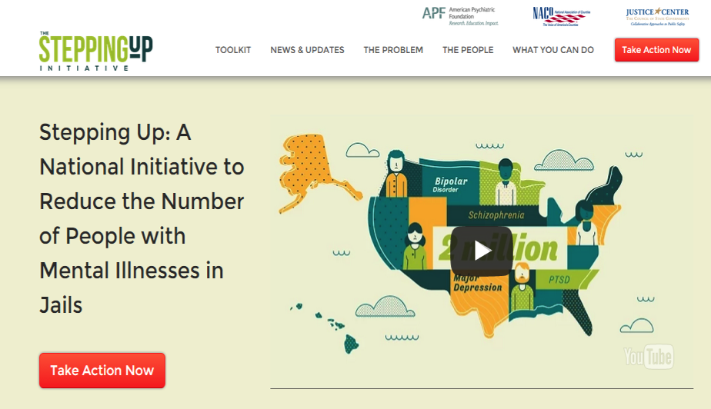
Get Involved in County Initiatives

Slide 46
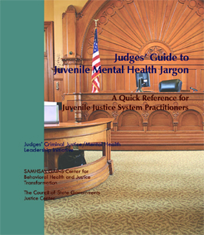
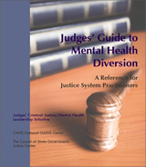
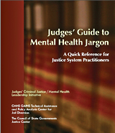
Judges’ and Psychiatrists’ Leadership Initiative (JPLI)
Mission of the JPLI
The Judges’ and Psychiatrists’ Leadership Initiative (JPLI) aims to stimulate, support, and enhance efforts by judges and psychiatrists to improve judicial, community, and systemic responses to people with behavioral health needs who are involved in the justice system.
  Creating a community of judges and psychiatrists
  Increasing the reach of trainings
  Developing educational resources
  Three Judges’ Guides
  Subscribe to the JPLI Newsletter
Notes:
Judge Leifman to do this slide, then pass to Allison to explain the project in more detail
The Judges’ and Psychiatrists’ Leadership Initiative (JPLI) aims to stimulate, support, and enhance efforts by judges and psychiatrists to improve judicial, community, and systemic responses to people with behavioral health needs who are involved in the justice system by:
Creating a community of judges and psychiatrists through web-based and in-person trainings, and the development and distribution of a newsletter to judges and psychiatrists;
Sign up for the Judges’ and Psychiatrists’ Leadership Initiative Newsletter using the forms being circulated in this session
Increasing the reach of trainings in order to build the non-clinical skills of court professionals, which will help improve individual and public safety outcomes;
JPLI partnered with the American Psychiatric Association Foundation and the Psychiatric Leadership Group for Criminal Justice to develop Judicial Work at the Interface of Mental Health & Criminal Justice, a training module for judges on addressing behavioral health issues when they arise in the courtroom. The training has been presented to more than 850 judges from 14 states and Washington, DC. Pairs of judges and psychiatrists from around the country have also been trained to present the module.
Apply for the Judicial Work at the Interface of Mental Health and Criminal Justice judge's training here.
Developing educational resources to increase judges’ and psychiatrists’ understanding of the latest research and best practices for people with mental illnesses involved in the justice system.

Slide 47
Federal and State Funding
Federal Funding
Sustainability Tips
State Funding
Question & Answer

Slide 48

State Accountability Court
Funding Opportunities

Slide 49

State Funding Opportunities
There are three times each Fiscal Year that a court can apply for State Grant Funds.
Fiscal Year Accountability Court Grant
Fiscal Year Supplemental Grant
Emergency Funds

Slide 50

Fiscal Year Accountability Court Grant
Released in February on the CJCC and CACJ websites.
Due back to CJCC at the end of March.
Awards mailed to courts in May.
Courts to present to Board of Commissioners and meet with county officials in May.
Award period from July 1st to June 30th.

Slide 51
Fiscal Year Supplemental Accountability Court Grant
Released in September on the CJCC and CACJ websites.
Due back to CJCC in October.
Awards mailed to courts in December.
Courts to present to Board of Commissioners and meet with county officials in December.
Award period from January 1st to June 30th.

Slide 52

Emergency Funds
NEW process for FY17.
Released in January on CJCC and CACJ Website.
Limited to drug testing and treatment requests.
Must demonstrate a true need and provide adequate justification.
Typically requests would be to account for unanticipated program growth and/or denial of requested FY Accountability Court Grant funds and/or FY Supplemental Grant funds.
REMEMBER – The court MUST provide adequate justification and demonstrate a true need.

Slide 53
CACJ Funding Committee
OBJECTIVE: The primary objective of the Committee is the administering of all grants and funds on behalf of the Council. In addition, it shall the funding committee’s responsibility to administer the budget and payroll of the council.
RESPONSIBILITIES:
The responsibilities of the Committee shall be to:
  Receive, review and recommend funding requests on behalf of the accountability court programs throughout the state;
  Maintain not only the control of expenditures in accordance with budgetary provisions but also the compilation of data to serve as a guide in the preparation of future budgets;
  Determine funding priorities for accountability courts based on direction by the Council;
  Administer and allocate any state or federal grant funds made available to the Council;
  Provide direction to the Criminal Justice Coordinating Council on finance matters as needed.

Slide 54
CACJ Funding Committee
How the CACJ Funding Committee Work????
Currently the CACJ has a number of standing committees, one of which is Funding.
The money for grants is appropriated to CJCC and granted out at the direction of the CACJ.
The committee and staff of CACJ, CJCC and many of the DCAs meet for two days in April to review the grant applications and decide the awards.

Slide 55

Accountability Court Funding History
Original appropriation was to CJCC for FY 2013 budget in the amount of $11,633,682. This was divided into 3 accounts: Felony courts; DUI, Family & Juvenile courts; DOC (DRC Lite).
The amount was gradually increased annually until the amount for FY 2018 was $25,726,260.00, Of that amount $21,130,921.00 was granted to Adult Felony Drug Courts, Mental Health Courts, Family Treatment Courts, Veterans Treatment Courts, DUI and Juvenile Drug or Mental Health Courts.

Slide 56
Other items funded by State money
FY 2018
Training and annual conference.
Day Reporting Center Lites through the Department of Community Supervision.
Case management hosting and maintenance.
Position with Department of Driver Services (DDS).
Project & positions with Department of Behavioral Health & Developmental Disabilities (DBHDD).
Transportation funds.
Administrative costs of the CACJ office.
Notes:
Mention other sources of funding—Samsa grants, BJA grants, county funding, participant fees, local donations.

Slide 57
Federal and State Funding
Federal Funding
Sustainability Tips
State Funding
Question & Answer
Notes:
Bonnie thanks panelists and takes q&a
Bonnie closes and goes to ‘thank you slide’

Slide 58
Contact Information
Sarah Wurzburg, Deputy Program Director, CSG Justice Center, swurzburg@csg.org
Taylor Jones, Executive Director, Council of Accountability Court Judges, Taylor.Jones@georgiacourts.gov
Notes:
Bonnie

Slide 59

Thank You
Join our distribution list to receive
CSG Justice Center project updates!
csgjusticecenter.org/subscribe
For more information, contact Olivia Randi, orandi@csg.org.
The presentation was developed by members of the Council of State Governments (CSG) Justice Center staff. The statements made reflect the views of the authors, and should not be considered the official position of the CSG Justice Center, the members of The Council of State Governments, or the funding agencies supporting our work.
Notes:
Bonnie

Slide 60


