Slide 1
Personality Disorders: Identification, Management and Treatment
September, 2017
Kevin Baldwin, Ph.D.
Applied Research Services, Inc.

Slide 2
The (relatively) new DSM-V
Single Axis: Previously the DSM organized clinical assessment into five areas (axes) addressing the different aspects and impact of disorders.
Multiaxial system was introduced to solve defunct problem: Certain disorders, like personality disorders, had received inadequate clinical and research focus.

Slide 3
Single Axis in DSM-V
Originally, personality disorders were placed on Axis II to receive greater attention
Burdensome and time consuming
No fundamental difference between disorders described on DSM-IV’s Axis I and II
DSM-5 shifted to single axis system combining the first three axes from past editions of DSM into one axis with all mental and other medical diagnoses
(2013, American Psychiatric Association Press. Personality Disorders Fact Sheet)

Slide 4
What is a Personality Disorder?
“[A] personality disorder can be diagnosed if there are significant impairments in self and interpersonal functioning together with one or more pathological personality traits. In addition, these features must be:
Relatively stable across time and consistent across situations;
Not better understood as normative for the individual’s developmental stage or sociocultural environment; and
Not solely due to the direct effects of a substance or general medical condition.

Slide 5
A Caution about Diagnoses
Diagnoses are not things, they cannot be observed – they are constructs that represent clusters of symptoms that often occur together.
When describing disorders such as depression or schizophrenia, we think of these as categorical rather than continuous constructs. Basically, you either have schizophrenia or you don’t (based on the number of symptoms you have).

Slide 6
A Caution about Diagnoses
Personality features occur on a continuum.
Traits such as narcissism occur along a dimension, rather than as a dichotomous category.

Slide 7
Categorical or Continuous?
DSM-V continues the categorical model
The proposed dimensional model has only six personality disorders
The most common personality disorder is PD-NOS = Not Otherwise Specified (means the diagnostician could not decide which of the ten personality disorders applied)
Notes:
The current version of our diagnostic manual (DSM-V) sticks with the old categorical model. The next revision may well use the dimensional model. The dimensional model has only six personality disorders, as it did not find enough research for four of the ones carried over from the DSM-IV. The most common of the personality disorders is PD-NOS, which means that the diagnostician could not decide which of the ten personality disorders applied, and thus used the Not Otherwise Specified” label.

Slide 8
Characteristics of Personality Disorders
Personality disorders are characterized by four primary features:
Distorted thinking patterns
Problematic emotional responses
Difficulties with impulse control (either over- or under-regulation)
Interpersonal issues

Slide 9
Characteristics of Personality Disorders
It’s not enough to simply exhibit the features that characterize the personality disorder – the features must cause significant and enduring difficulties navigating through life

Slide 10
The Ten Personality Disorders
Antisocial
Avoidant
Borderline
Dependent
Histrionic
Narcissistic
Obsessive-Compulsive
Paranoid
Schizoid
Schizotypal

Slide 11
“Fiction is the lie through which we tell the truth”
― Albert Camus, French philosopher and author
Let’s look to fictional characters to tell us the truth about personality disorders
Guess which personality disorder is being portrayed by each character

Slide 12
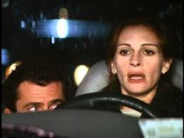
Enemy of the State
Conspiracy Theory

Slide 13
Cluster A (Odd, bizarre, eccentric)
Paranoid personality disorder pervasive distrust of others, including friends, family, and partners
Guarded, suspicious of others, constantly looking for clues or suggestions to validate fears
Strong sense of personal rights, especially sensitive to setbacks and rebuffs, feels shame and humiliation, often holds grudges
Tends to withdraw from others and to struggle with building close relationships

Slide 14
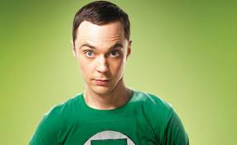
Sheldon Cooper in Big Bang Theory

Slide 15
Cluster A, cont.
Schizoid PD detached, aloof, prone to Introspection and fantasy.
Does not want social or sexual relationships due to indifference
Little, or no, emotional response
May be high functioning, and do not appear to be bothered by their apparent oddness
Notes:
One theory: these persons actually desire intimacy but find initiating and maintaining relationships either too difficult or distressing, and thus they retreat into their inner world.

Slide 16
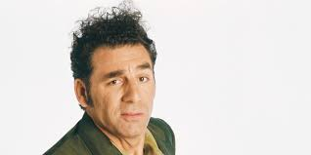
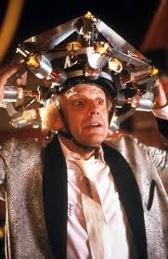
Doc Brown
Kramer

Slide 17
Cluster A, cont.
Schizotypal PD Oddities of appearance, behavior, and speech, unusual perceptual experiences, and strange thinking and experiences often seen in schizophrenia
Fears social interaction, thinks of others as harmful
Increased likelihood of developing schizophrenia – hence the former name for this disorder, ‘latent schizophrenia’
Notes:
(magical thinking, thinking that speaking of something can make it appear and Ideas of Reference - beliefs that events are somehow related to them).

Slide 18
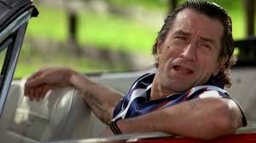
Robert DeNiro in Cape Fear

Slide 19
Cluster B (dramatic, emotional, erratic)
Antisocial PD – pervasive pattern of disregard for the rights of other people and for the rules of society
Aggression, deceit, and risk-taking behaviors are common as is impulsiveness
Often in trouble with the authorities
Rarely takes responsibility for their problems
Most common PD in justice settings

Slide 20
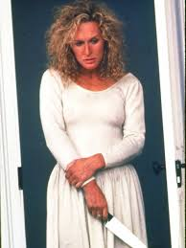
Glenn Close in Fatal Attraction

Slide 21
Cluster B, cont.
Borderline PD Lack of a sense of self
Powerful feelings of emptiness and strong fears of abandonment
Relationships typically intense but unstable,
Emotional instability, outbursts of anger and violence (especially when they feel criticized or demeaned), and impulsive behavior
Suicidal threats and acts of self-harm common
From their perspective, you are either ALL good or ALL bad – there are no shades of grey
Notes:
Borderline PD was thought to lie on the ‘borderline’ between anxiety disorders and psychotic disorders such as schizophrenia and bipolar disorder.

Slide 22
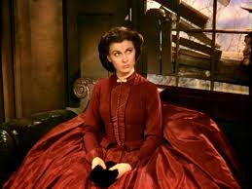
Vivien Leigh in Gone With the Wind

Slide 23
Cluster B. cont.
Histrionic PD Lack of self-worth, dependent on attracting the attention and approval of others
Overly dramatic and showy, as if playing a part
Takes great care of their appearance
Can come across as overly charming or, inappropriately seductive
Impulsive and may engage in dangerous risk-taking behaviors
Can be perceived as insincere

Slide 24
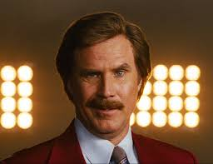
Will Ferrell in Anchorman

Slide 25
Cluster B, cont.
Narcissistic PD – Need to be admired
Often envious & believes others feel the same
Lacks empathy - inability to see others’ perspective
Self-absorbed, controlling, selfish, or insensitive
Frustration quickly escalates into destructive anger and revenge (narcissistic rage)
Consider themselves unique and special and deserving to be treated as such
Inflated sense of worth

Slide 26
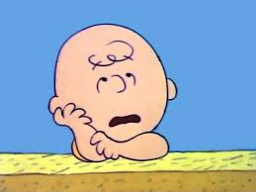
Charlie Brown

Slide 27
Cluster C (anxious, fearful)
Avoidant PD – Socially incompetent, unappealing, or inferior
Constantly fears being criticized, rejected, and abandoned
Avoids social situations, guarded in intimate relationships
Focuses on the internal reactions of themselves and the perception of others, preventing them from behaving naturally or comfortably in social situations

Slide 28
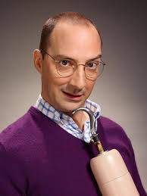
“Buster Bluth” in Arrested Development

Slide 29
Cluster C, cont.
Dependent PD Helpless in making everyday decisions, often surrenders important life decisions to others
Fears abandonment and goes overboard to obtain/maintain relationships
Little self-confidence, needs to be cared for
Maintains a naïve and childlike perspective
Displays little insight into themselves or others
Excessive dependency leaves them vulnerable to abuse and exploitation

Slide 30
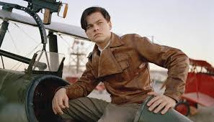
Leonardo DiCaprio as Howard Hughes

Slide 31
Cluster C, cont.
Obsessive-Compulsive PD – Focuses excessively on often rigid rules, regulations, and orderliness at the expense of being open and flexible
Perfectionism
Tendency to focus on lists at expense of social relationships
Perceived as controlling, miserly, excessively rigid, stubborn

Slide 32
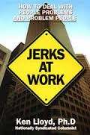
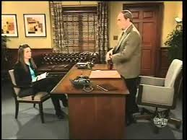
Management and Treatment
Newhart SNL skit –
“Just Stop It”

Slide 33
Treatment Options
Borderline: Dialectic Behavior Therapy (DBT); Mentalization-Based Treatment
Antisocial: Schema Therapy
Narcissistic: Psychodynamic, Schema Therapy
Histrionic: Psychodynamic
Cont.

Slide 34
Treatment Options
Schizotypal, Schizoid, Paranoid: Medication; Social Skills Training
Avoidant, Obsessive-Compulsive, Dependent: Behavioral; Social Skills Training; Psychodynamic; Medication

Slide 35
Thank you!

Slide 36
Kevin Baldwin, Ph.D.
Applied Research Services, Inc.
Voice: 404-881-1120
kbaldwin@ars-corp.com
www.ars-corp.com
Presented at: 2017 CACJ Accountability Court Conference – Athens, GA

Slide 37
Visit our web site at www.ars-corp.com
or call (404) 881-1120
CACJ 2017 Accountability Court Conference – September, 2017

