Slide 1
The Prevalence & Potential Impact of Trauma on Justice-Involved Youths
Lisa Callahan, PhD
September 18, 2017

Slide 2
Background
Science
Adolescent brain development
Observable impact of trauma on adults
Money
Cost of justice system
Politics
“Raise the age”
Acknowledgement of trauma in other populations (e.g. soldiers)

Slide 3
SAMSHA’s Definition of Trauma
Individual trauma results from an event, series of events, or a set of circumstances that is experienced by an individual as physically or emotionally harmful or threatening and that has lasting adverse effects on the individual’s functioning and physical, social, emotional, or spiritual well-being.

Slide 4
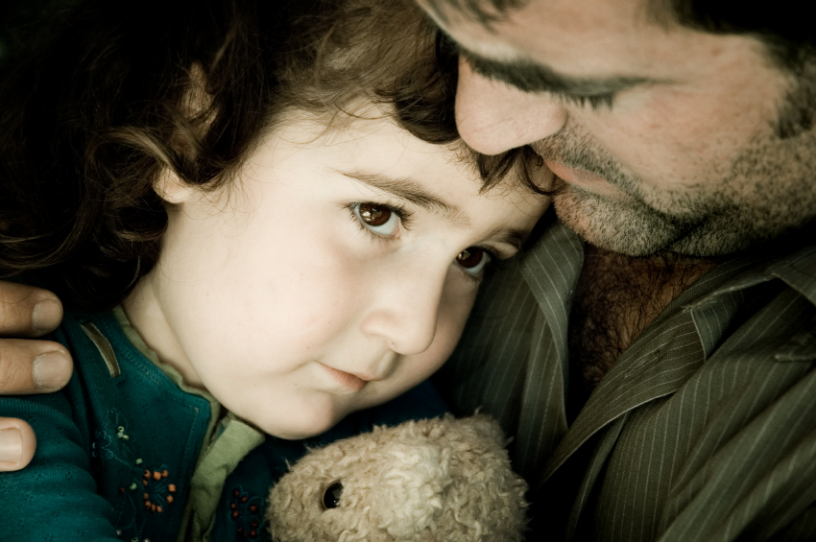
Event
Experience
Effect

Slide 5
Examples of Traumatic Events Children Experience
Intentional trauma – abuse, bullying, rape, violence in community, exposure to violence
Unintentional trauma – sudden death or illness of loved one, serious injuries/illness, separation from care giver, family disruption
Other types – historical trauma, community trauma, poverty, homelessness, vicarious trauma, ethnic cleansing, war

Slide 6
Risk Factors for Trauma in Youths
Race/ethnicity
LGBTQ
Socio-ecological factors (e.g. poverty)
Lower cognitive abilities
Negative cognitive bias for coping
Personality disorder (e.g. hostility)
Mental illness
Psychophysiological factors
DiGangi & et al., 2013

Slide 7
Long-term Effects of Trauma
Physical Health Issues
Substance
Abuse
Fear
Powerlessness
Anger
Pain
Mental Health Issues
Poor Relationships
Behavioral Problems

Slide 8
Signs of Trauma in Youths
Aggression & anger
Anxiety & depression
Conduct disorder/opp-defiant behavior
Distrust
Hyperarousal
Impaired information processing
Impulse control problems
Problems with personal boundaries
Sleep disruption
School problems
Somatic complaints
Substance use
Suicidal ideation/attempts/self-harm

Slide 9
Behavior – Coping & Survival
Hopelessness (indifference)
Aggression (self & others)
Hypervigilance (distrustful)
In the moment, unfocused (no goals)
Resentful (holds grudges)
When the brain is stressed – a person cannot think, plan, or execute.

Slide 10
Trauma is part of the puzzle
Substance Use
Mental Disorder
Trauma

Slide 11
How pervasive is childhood trauma?

Slide 12
Adverse Childhood Events (ACE) Comparison Across Samples
 | US Adults¹ N=17,000+ | ATC² N=90 | JMHC³ N=54 | CA – CHC⁴ N=701 | FL – Boys⁵ N=50,000+ | FL – Girls⁶ N=17.000+
Physical Abuse | 11% | 70% | 27% | 6% | 39% | 11%
Emotional Abuse | 28% | 93% | * | 5% | 41% | 28%
Sexual Abuse | 21% | 31% | 22% | 4% | 31% | 21%
Emotional Neglect | 15% | 94% | 56% | 12% | 39% | 15%
Physical Neglect | 10% | 29% | 2% | * | 18% | 10%
Mother/Other HH Treated Violently | 13% | 83% | 24% | 11% | 84% | 13%
HH Substance Abuse | 27% | 45% | 43% | 25% | 30% | 27%
HH Mental Illness/Suicide | 19% | 37% | 44% | 11% | 12% | 19%
Parents Sep/Div, 1/0 Parents | 23% | 68% | 68% | 62% | 84% | 23%
HH Member Incarcerated | 5% | 30% | 35% | 12% | 68% | 5%
¹ Feletti et al., 1998 ³ Callahan et al., 2014
² IL Tx Ct ^{4,5} Fox et al., 2015

Slide 13
Trauma & Justice-involved Youth
NCTSN Study – justice-involved youth ages 13-18 (N=658)
Findings:
Average # of trauma types ~5
PTSD – 24% clinical range
Academic problems – 72%
Substance use – 44%
Child welfare involvement – 42%
Age of onset – 1st year of life 34%, ages 1-5 28%
Multiple traumas – 90%
Dierkhising, Ko, et al., 2013
Notes:
Types of trauma: loss/bereavement 61%; impaired caregiver 52%; DV 52%; emotional/psych maltreatment 50%; physical maltreatment 39%; community violence 34%
Externalizing problems 66% (rule breaking, aggressive behavior); internalizing symptoms (22% withdrawn/depression, 21% anxiety/depression, and 20% somatic problems).

Slide 14
National Survey of Children’s Exposure to Violence
Random national sample of 4000 children in U.S. ages 0-18
Findings:
37% experienced a physical assault in past year, peaks ages 6-9 (51% over lifetime) B>G
5% experienced a sexual assault in past year, peaks ages 14-17 (8.4% over lifetime) G>B
15% experienced any maltreatment in past year, peaks 14-17 (25% over lifetime) B=G
27% experienced any property crime in past year, peaks 14-17 (41% over lifetime) B>G
25% witnessed violence in past year, peaks 14-17 (38% over lifetime) B=G; boys more likely to witness community violence and girls family violence
Finkelhor, Turner, Shattuck, & Hamby, 2015

Slide 15
National Crime Victim Survey (NCVS)
2005-2014, 12-17 years old
Findings:
591,000 average annual # of violent victimizations
463,000 single events
127,300 repeated events
Prevalence rates: (highest for any age group)
1.9% - single events
.5% - repeated events
Findings from total sample (12 and older):
Repeated victimization higher for females than males
DV and rape/sexual assault highest rates of re-victimization of any violent crime
Notes:
Violent victimization includes rape or sexual assault, robbery, agg assault, and simple assault
ELEVATED RISK: Males for single event, no difference for repeated events; 24 & younger for single events, 17 & under for repeated events; African Americans & Hispanics for single events but not repeated

Slide 16
Expanding Definitions of Adversity
ACES include 10 items
Broadening the Focus – Additional items:
Low SES – contributes to lower physical health score
High peer victimization – contributes to higher distress symptoms
High peer social isolation – contributes to higher distress symptoms
High exposure to community violence – contributes to higher distress symptoms
Finkelhor, Shattuck, Turner, & Hamby, 2015
Notes:
~400,000 children in foster care in the US in 2015
~18.3 million children live in immigrant families; 7.3 million whose parents are not citizens; 2.5 million not born in US
3.4 million children live in homes with no working adult
10 million kids ilve in high poverty neighborhoods
19% of 4th graders are chronically absent from school
Expulsion rate is for African American youths is 3x that for white youths

Slide 17
Homelessness & Poverty in the Georgia
9,849 Total households in GA experienced homelessness
How many children in GA experienced homelessness in 2016?
2,220 are children under age 18 living with adult
17 are children living with no adult
Poverty rates in US:
25% of GA children live in poverty (FPL); 11% live in deep poverty (50%< FPL)
9% of children live in home where no adult works
532,000 children lived with food insecurity in past year
~427,000 HH with children receiving SNAP
HUD 2016 CoC PIT; Kids Count
Notes:
336,076 HH w/o children; 61,265 HH w/ child/ren; 3,720 HH only children such as adolescent parents
11% of Blacks in deep poverty; 9% Hispanics; 4% whites
10% families with children under 6 live in deep poverty, 8% with children under 18
46 million people received SANP in 2015; 20 million children live in families that receive public assistance

Slide 18
Examples of Potentially Traumatic Events for Children in Georgia
17% of 4th graders in GA are chronically absent from school
29,000 (5%) teens 16-19 not in school and not HS graduates
141,000 children living with neither parent
136,000 children living with grandparents
10,934 children in foster care
11% of children living in poverty have no health insurance
292 15-19 year old deaths due to homicide, suicide, & accident
381 0-14 year old deaths, all causes

Slide 19
NIJ Funded – 2 Juvenile Treatment Courts
1 COD & 1 JMHC with comparison group (had MI/SUD)
62% males, 50/50 White/Black
Families significantly worse off for income, education, & employment than state averages
43% caregivers single/not living with partner
39% caregivers unemployed
Most caregivers were mothers or grandmothers

Slide 20
Treatment Court Youths’ School Experiences
Nearly 75% had repeated a grade
90% had an IEP
96% had school disciplinary actions

Slide 21
Treatment Court Youths’ Household Experiences
Youth Report
Caregiver report
33% - street drug use in home
66% - parents sep/divorced
28% - ever lived in foster care
2x more likely to run away than siblings
52% - family mental illness
28% - family suicide attempt
31% - family prison
36% - family member SU Tx
61% - family member convicted of crime
57% - family member psych hospitalization
66% - youth in HH w/ DV
75% youth witnessed DV

Slide 22
Youth Reports of DV Witnessed
Father -> Mother
Mother -> Father
44% - pushed, grabbed, slapped, threw something
24% - kicked, bit, or hit with fist or something hard
23% - repeatedly hit over a few minutes
12% - threatened with a knife or gun, or used weapon to hurt her
28% - pushed, grabbed, slapped, threw something
20% - kicked, bit, or hit with fist or something hard
20% - repeatedly hit over a few minutes
0% -threatened with a knife or gun, or used weapon to hurt her

Slide 23
Other Experiences Reported
60% - often spanked
10% - often went hungry
21% - often called “lazy” or “ugly” by family
31% - parents too drunk/high to care for them
24% - had to wear dirty clothes
55% - often thought your parents wish you hadn’t been born
55% - often/very often family is source of strength & support

Slide 24
Parents’ Report about Treatment Court Youth
Fails to finish things
Enjoys very little
Restless
Confused
Shows brutality/bullying
Daydreams
Fearful
Has to be perfect
Gets in fights
Impulsive
Physically attacks others
Picks at skin etc.
Refuses to talk
Runs away from home
Sees things not there
Sulks
Talk/walks in sleep
Trouble sleeping
Unhappy, sad, depressed
Worries
Nervous
Significantly more likely than typical youths

Slide 25
Trauma Experiences of Detained Youth
Prevalence in detained youth:
93% - at least one (of 8) trauma event
84% - more than one trauma event
57% - 6 or more traumas; 15 events average
Type:
Witnessing violence (74%)
Threatened with weapon (58%)
Situation you or someone close was going to be hurt badly or die (53%)
Males v females:
Males more likely to have been in a bad accident
Females more likely to have been sexually assaulted
PTSD:
11% of males & 15% of females
93% of youths with PTSD have co-morbid psychiatric disorder; 50+% have 2
Males are more likely than females to have co-morbid disorder with PTSD
Abram, Teplin, King, et al., 2013

Slide 26
Building Trauma-informed Juvenile Justice Systems
Juvenile justice system in unique position to address multiple problems in youths.
Implement effective screening for trauma AND have evidence-based practices available for youths experiencing trauma responses.
Screening – age appropriate, validated for specific populations
Child Trauma Screen – 10 item (4 events, 6 reactions) – children 7 and older
Assessment
Treatment
TARGET – Trauma Affect Regulation: Guide for Education & Treatment
TF-CBT – Trauma-focused CBT
Cross-system engagement
Promote resilience & engagement among youths
and their families

Slide 27
A Trauma-informed Approach – the 4 R’s
Realize the prevalence of trauma & why a trauma-informed approach is important
Recognize how trauma affects all individuals in an organization, program, system, & workforce
Respond effectively & with compassion
Resist Re-traumatization

Slide 29
Contact Information & Questions
Lisa Callahan, PhD
SAMHSA’S GAINS Center
Policy Research Associates, Inc.
Delmar NY 12054
lcallahan@prainc.com

